Slide 1
Structure-based Protein Engineering Hongmin Zhang

Slide 2
Outlines
General introduction
Protein structure and function
Application of protein engineering
II. Strategies and approaches of protein engineering research
Directed evolution
Rational design
De novo design
III. Rational design and De novo design in research and industrial applications
Stability improvement
Activity switch and enhancement
Enzyme specificity

Slide 3
Proteins
Proteins
are polymers constructed from amino acid monomers,
account for more than 50% of the dry weight of most cells,
perform most of the tasks required for life, and
form enzymes, chemicals that change the rate of a chemical reaction without being changed in the process.
Notes:
3
Student Misconceptions and Concerns
1. The abstract nature of chemistry can be discouraging to many students. Consider starting out this section of the lecture by examining the chemical groups on a food nutrition label. Candy bars with peanuts are particularly useful as they contain significant amounts of all three sources of calories (carbohydrates, proteins, and lipids). 2. Students might struggle to extrapolate the properties of lipids to their roles in an organism. Ducks float because their feathers repel water instead of attracting it. Hair on your head remains flexible because of oils produced in your scalp. Examples such as these help connect the abstract properties of lipids to concrete examples in our world. 3. The functional significance of protein shape is an abstract molecular example of form and function relationships, which might be new to some students. The binding of an enzyme to its substrate is a type of molecular handshake, which permits specific interactions. To help students think about form and function relationships, share some concrete analogies in their lives—perhaps flathead and Phillips screwdrivers that match the proper type of screws or the fit of a hand into a glove. 4. The evolution of lactose tolerance within human groups in East Africa does not represent a deliberate decision, yet this evolutionary change appears logical. Many students perceive adaptations as deliberate events with purpose. As students develop a better understanding of the mechanisms of evolution, it will be important to point out that mutations arise by chance, with the culling hand of natural selection favoring traits that convey an advantage. Organisms cannot plan evolutionary change.
Teaching Tips
1. Consider reinforcing the three main sources of calories with food items that clearly represent each group. Bring clear examples to class as visual references; for example, a can of Coke or a bag of sugar for carbohydrates, a tub of margarine for lipids, and some beef jerky for protein (although some fat and carbohydrates might also be included). 2. If your lectures will eventually include details of glycolysis and aerobic respiration, this is a good point to introduce the basic concepts of glucose as fuel. Just introducing this conceptual formula might help: eating glucose + breathing in oxygen (yields) water + usable energy (used to build ATP) + heat + exhaled CO₂. 3. The section about our use of sugars may be of considerable interest to your students, who might not be expecting much interest in a lecture about organic chemistry. Consider an assignment for each student to bring to class a product label indicating high-fructose corn syrup (HFCS) as an ingredient. 4. Learning the definitions of word roots is invaluable when learning science. Learning the meaning of the prefix word roots “mono” (one), “di” (two), and “poly” (many) helps to distinguish the structures of various carbohydrates. 5. Consider an assignment for students to find reliable sources that discuss high sugar consumption in the modern diet. The key, of course, is in the quality of the resource. Consider narrowing down the categories to certain nonprofit health organizations (American Cancer Society, American Heart Association, and the like) and peer-reviewed journals. 6. A simple exercise demonstrates the enzymatic breakdown of starches into sugars. If students place an unsalted cracker in their mouths, holding it in their mouths while it mixes well with saliva, they might soon notice that a sweeter taste begins to emerge. The salivary enzyme amylase begins the digestion of starches into disaccharides, which may be degraded further by other enzymes. These disaccharides are the source of the sweet taste. 7. The cellophane wrap often used to package foods is a biodegradable material derived from cellulose. Consider challenging students to create a list of other cellulose-derived products (such as paper). 8. An adult human may store about a half of a kilogram of glycogen in the liver and muscles of the body, depending on recent dietary habits. A person who begins dieting might soon notice an immediate weight loss of 2–4 pounds (1–2 kilograms) over several days, reflecting reductions in stored glycogen, water, and intestinal contents (among other factors). 9. Another simple demonstration can illustrate hydrophobic and hydrophilic substances. In front of the class, mix colored water and a yellow oil (corn or canola oil work well). Shake up the mixture and then watch as the two separate. (You may have a mixture already made that remains separated; however, the dyes may bleed between the oil and the water.) 10. Margarine in stores commonly comes in liquid squeeze containers, in tubs, and in sticks. These forms reflect increasing amounts of hydrogenation, gradually increasing the stiffness from a liquid, to a firmer spread, to a firm stick of margarine. As noted in the text, recent studies have suggested that unsaturated oils become increasingly unhealthy as they are hydrogenated. Perhaps your students can find references to this correlation on the Internet. 11. Many analogies relate to students the diversity of proteins that can be made from just 20 amino acids. The authors note that our language uses combinations of 26 letters to form words. Proteins are much longer “words”, creating even more diversity. Another analogy is to trains. This builds on the earlier analogy when polymers were introduced. Imagine making different trains about 100 cars long, using any combination of 20 types of railroad cars. Mathematically, the number of possible trains is 20¹⁰⁰, a number beyond imagination. 12. The authors note that the difference between a polypeptide and a protein is analogous to the relationship between a long strand of yarn and a sweater knitted from yarn. Proteins are clearly more complex! 13. Most cooking results in changes in the texture and color of a food. The brown color of a steak is the product of the denaturation of proteins. Fixatives such as formalin also denature proteins and cause color changes. Students who have dissected vertebrates will realize that the brown color of the muscles makes it look as if the animal has been cooked. 14. Consider this assignment to wrap up the presence of organic molecules in our diets. Have students working individually or in small groups analyze a food label listing the components of a McDonald’s Big Mac. Note the most abundant organic molecule class (perhaps by weight) found in each component. 15. The “NA” in DNA and RNA represents ‘nucleic acid”. Students often do not make this association without assistance.

Slide 4
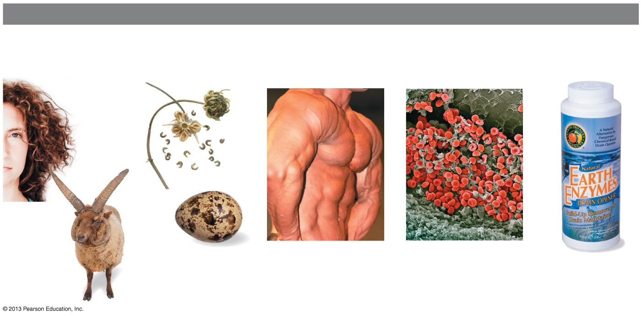
MAJOR TYPES OF PROTEINS
Structural Proteins
(provide support)
Storage Proteins
(provide amino
acids for growth)
Contractile
Proteins
(help movement)
Transport Proteins
(help transport
substances)
Enzymes
(help chemical
reactions)
Notes:
4
Figure 3.15 Some types of proteins

Slide 5
The Monomers of Proteins: Amino Acids
All proteins are macromolecules constructed from a common set of 20 kinds of amino acids.
Each amino acid consists of a central carbon atom bonded to four covalent partners.
Three of those attachment groups are common to all amino acids:
a carboxyl group (-COOH),
an amino group (-NH₂), and
a hydrogen atom.
Notes:
5
Student Misconceptions and Concerns
1. The abstract nature of chemistry can be discouraging to many students. Consider starting out this section of the lecture by examining the chemical groups on a food nutrition label. Candy bars with peanuts are particularly useful as they contain significant amounts of all three sources of calories (carbohydrates, proteins, and lipids). 2. Students might struggle to extrapolate the properties of lipids to their roles in an organism. Ducks float because their feathers repel water instead of attracting it. Hair on your head remains flexible because of oils produced in your scalp. Examples such as these help connect the abstract properties of lipids to concrete examples in our world. 3. The functional significance of protein shape is an abstract molecular example of form and function relationships, which might be new to some students. The binding of an enzyme to its substrate is a type of molecular handshake, which permits specific interactions. To help students think about form and function relationships, share some concrete analogies in their lives—perhaps flathead and Phillips screwdrivers that match the proper type of screws or the fit of a hand into a glove. 4. The evolution of lactose tolerance within human groups in East Africa does not represent a deliberate decision, yet this evolutionary change appears logical. Many students perceive adaptations as deliberate events with purpose. As students develop a better understanding of the mechanisms of evolution, it will be important to point out that mutations arise by chance, with the culling hand of natural selection favoring traits that convey an advantage. Organisms cannot plan evolutionary change.
Teaching Tips
1. Consider reinforcing the three main sources of calories with food items that clearly represent each group. Bring clear examples to class as visual references; for example, a can of Coke or a bag of sugar for carbohydrates, a tub of margarine for lipids, and some beef jerky for protein (although some fat and carbohydrates might also be included). 2. If your lectures will eventually include details of glycolysis and aerobic respiration, this is a good point to introduce the basic concepts of glucose as fuel. Just introducing this conceptual formula might help: eating glucose + breathing in oxygen (yields) water + usable energy (used to build ATP) + heat + exhaled CO₂. 3. The section about our use of sugars may be of considerable interest to your students, who might not be expecting much interest in a lecture about organic chemistry. Consider an assignment for each student to bring to class a product label indicating high-fructose corn syrup (HFCS) as an ingredient. 4. Learning the definitions of word roots is invaluable when learning science. Learning the meaning of the prefix word roots “mono” (one), “di” (two), and “poly” (many) helps to distinguish the structures of various carbohydrates. 5. Consider an assignment for students to find reliable sources that discuss high sugar consumption in the modern diet. The key, of course, is in the quality of the resource. Consider narrowing down the categories to certain nonprofit health organizations (American Cancer Society, American Heart Association, and the like) and peer-reviewed journals. 6. A simple exercise demonstrates the enzymatic breakdown of starches into sugars. If students place an unsalted cracker in their mouths, holding it in their mouths while it mixes well with saliva, they might soon notice that a sweeter taste begins to emerge. The salivary enzyme amylase begins the digestion of starches into disaccharides, which may be degraded further by other enzymes. These disaccharides are the source of the sweet taste. 7. The cellophane wrap often used to package foods is a biodegradable material derived from cellulose. Consider challenging students to create a list of other cellulose-derived products (such as paper). 8. An adult human may store about a half of a kilogram of glycogen in the liver and muscles of the body, depending on recent dietary habits. A person who begins dieting might soon notice an immediate weight loss of 2–4 pounds (1–2 kilograms) over several days, reflecting reductions in stored glycogen, water, and intestinal contents (among other factors). 9. Another simple demonstration can illustrate hydrophobic and hydrophilic substances. In front of the class, mix colored water and a yellow oil (corn or canola oil work well). Shake up the mixture and then watch as the two separate. (You may have a mixture already made that remains separated; however, the dyes may bleed between the oil and the water.) 10. Margarine in stores commonly comes in liquid squeeze containers, in tubs, and in sticks. These forms reflect increasing amounts of hydrogenation, gradually increasing the stiffness from a liquid, to a firmer spread, to a firm stick of margarine. As noted in the text, recent studies have suggested that unsaturated oils become increasingly unhealthy as they are hydrogenated. Perhaps your students can find references to this correlation on the Internet. 11. Many analogies relate to students the diversity of proteins that can be made from just 20 amino acids. The authors note that our language uses combinations of 26 letters to form words. Proteins are much longer “words”, creating even more diversity. Another analogy is to trains. This builds on the earlier analogy when polymers were introduced. Imagine making different trains about 100 cars long, using any combination of 20 types of railroad cars. Mathematically, the number of possible trains is 20¹⁰⁰, a number beyond imagination. 12. The authors note that the difference between a polypeptide and a protein is analogous to the relationship between a long strand of yarn and a sweater knitted from yarn. Proteins are clearly more complex! 13. Most cooking results in changes in the texture and color of a food. The brown color of a steak is the product of the denaturation of proteins. Fixatives such as formalin also denature proteins and cause color changes. Students who have dissected vertebrates will realize that the brown color of the muscles makes it look as if the animal has been cooked. 14. Consider this assignment to wrap up the presence of organic molecules in our diets. Have students working individually or in small groups analyze a food label listing the components of a McDonald’s Big Mac. Note the most abundant organic molecule class (perhaps by weight) found in each component. 15. The “NA” in DNA and RNA represents ‘nucleic acid”. Students often do not make this association without assistance.

Slide 6
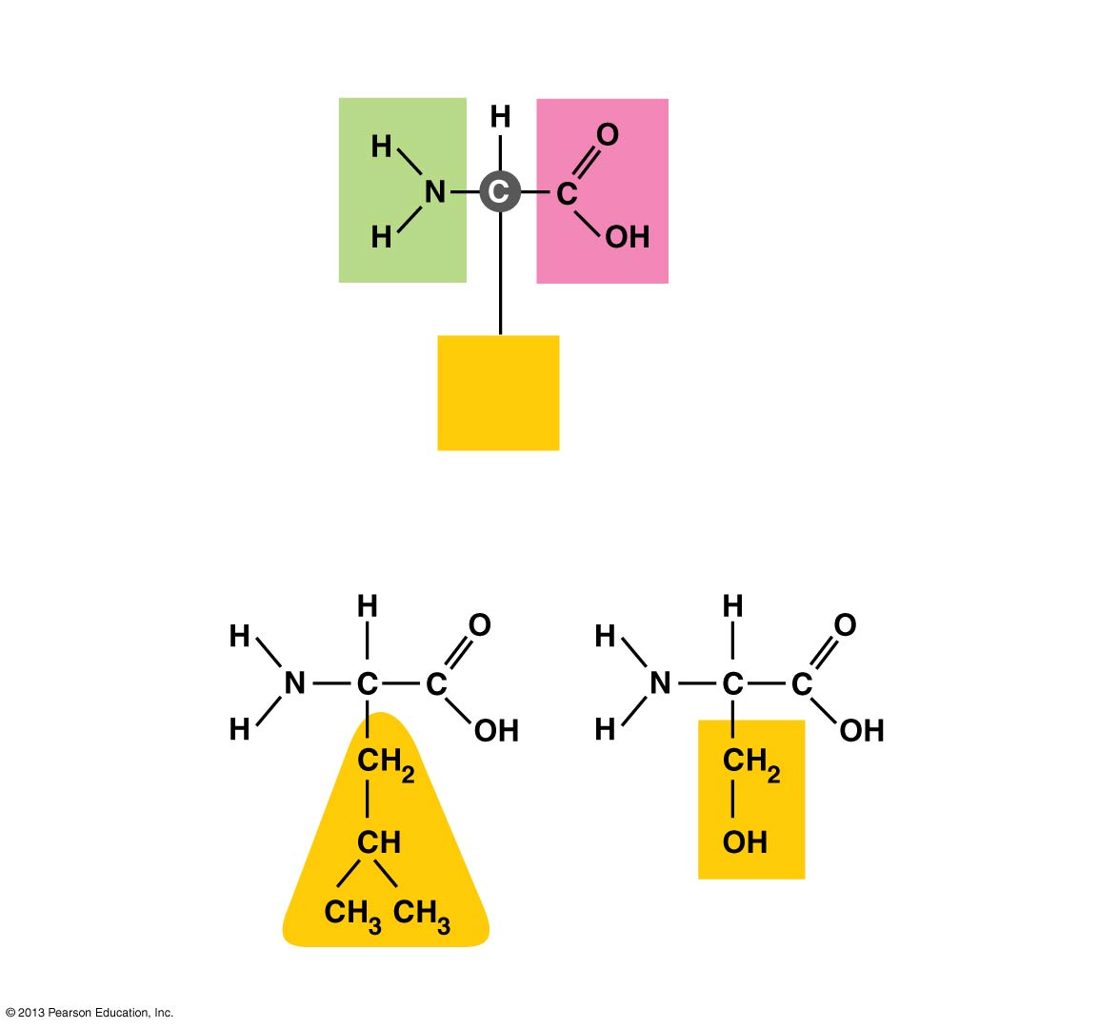
Amino
group
Carboxyl
group
Side
group
The general structure of an amino acid
Hydrophobic
side group
Hydrophilic
side group
Leucine
Serine
Notes:
6
Figure 3.16 Amino acids

Slide 7
Proteins as Polymers
Cells link amino acids together
by dehydration reactions,
forming peptide bonds, and
creating long chains of amino acids called polypeptides.
Notes:
7
Student Misconceptions and Concerns
1. The abstract nature of chemistry can be discouraging to many students. Consider starting out this section of the lecture by examining the chemical groups on a food nutrition label. Candy bars with peanuts are particularly useful as they contain significant amounts of all three sources of calories (carbohydrates, proteins, and lipids). 2. Students might struggle to extrapolate the properties of lipids to their roles in an organism. Ducks float because their feathers repel water instead of attracting it. Hair on your head remains flexible because of oils produced in your scalp. Examples such as these help connect the abstract properties of lipids to concrete examples in our world. 3. The functional significance of protein shape is an abstract molecular example of form and function relationships, which might be new to some students. The binding of an enzyme to its substrate is a type of molecular handshake, which permits specific interactions. To help students think about form and function relationships, share some concrete analogies in their lives—perhaps flathead and Phillips screwdrivers that match the proper type of screws or the fit of a hand into a glove. 4. The evolution of lactose tolerance within human groups in East Africa does not represent a deliberate decision, yet this evolutionary change appears logical. Many students perceive adaptations as deliberate events with purpose. As students develop a better understanding of the mechanisms of evolution, it will be important to point out that mutations arise by chance, with the culling hand of natural selection favoring traits that convey an advantage. Organisms cannot plan evolutionary change.
Teaching Tips
1. Consider reinforcing the three main sources of calories with food items that clearly represent each group. Bring clear examples to class as visual references; for example, a can of Coke or a bag of sugar for carbohydrates, a tub of margarine for lipids, and some beef jerky for protein (although some fat and carbohydrates might also be included). 2. If your lectures will eventually include details of glycolysis and aerobic respiration, this is a good point to introduce the basic concepts of glucose as fuel. Just introducing this conceptual formula might help: eating glucose + breathing in oxygen (yields) water + usable energy (used to build ATP) + heat + exhaled CO₂. 3. The section about our use of sugars may be of considerable interest to your students, who might not be expecting much interest in a lecture about organic chemistry. Consider an assignment for each student to bring to class a product label indicating high-fructose corn syrup (HFCS) as an ingredient. 4. Learning the definitions of word roots is invaluable when learning science. Learning the meaning of the prefix word roots “mono” (one), “di” (two), and “poly” (many) helps to distinguish the structures of various carbohydrates. 5. Consider an assignment for students to find reliable sources that discuss high sugar consumption in the modern diet. The key, of course, is in the quality of the resource. Consider narrowing down the categories to certain nonprofit health organizations (American Cancer Society, American Heart Association, and the like) and peer-reviewed journals. 6. A simple exercise demonstrates the enzymatic breakdown of starches into sugars. If students place an unsalted cracker in their mouths, holding it in their mouths while it mixes well with saliva, they might soon notice that a sweeter taste begins to emerge. The salivary enzyme amylase begins the digestion of starches into disaccharides, which may be degraded further by other enzymes. These disaccharides are the source of the sweet taste. 7. The cellophane wrap often used to package foods is a biodegradable material derived from cellulose. Consider challenging students to create a list of other cellulose-derived products (such as paper). 8. An adult human may store about a half of a kilogram of glycogen in the liver and muscles of the body, depending on recent dietary habits. A person who begins dieting might soon notice an immediate weight loss of 2–4 pounds (1–2 kilograms) over several days, reflecting reductions in stored glycogen, water, and intestinal contents (among other factors). 9. Another simple demonstration can illustrate hydrophobic and hydrophilic substances. In front of the class, mix colored water and a yellow oil (corn or canola oil work well). Shake up the mixture and then watch as the two separate. (You may have a mixture already made that remains separated; however, the dyes may bleed between the oil and the water.) 10. Margarine in stores commonly comes in liquid squeeze containers, in tubs, and in sticks. These forms reflect increasing amounts of hydrogenation, gradually increasing the stiffness from a liquid, to a firmer spread, to a firm stick of margarine. As noted in the text, recent studies have suggested that unsaturated oils become increasingly unhealthy as they are hydrogenated. Perhaps your students can find references to this correlation on the Internet. 11. Many analogies relate to students the diversity of proteins that can be made from just 20 amino acids. The authors note that our language uses combinations of 26 letters to form words. Proteins are much longer “words”, creating even more diversity. Another analogy is to trains. This builds on the earlier analogy when polymers were introduced. Imagine making different trains about 100 cars long, using any combination of 20 types of railroad cars. Mathematically, the number of possible trains is 20¹⁰⁰, a number beyond imagination. 12. The authors note that the difference between a polypeptide and a protein is analogous to the relationship between a long strand of yarn and a sweater knitted from yarn. Proteins are clearly more complex! 13. Most cooking results in changes in the texture and color of a food. The brown color of a steak is the product of the denaturation of proteins. Fixatives such as formalin also denature proteins and cause color changes. Students who have dissected vertebrates will realize that the brown color of the muscles makes it look as if the animal has been cooked. 14. Consider this assignment to wrap up the presence of organic molecules in our diets. Have students working individually or in small groups analyze a food label listing the components of a McDonald’s Big Mac. Note the most abundant organic molecule class (perhaps by weight) found in each component. 15. The “NA” in DNA and RNA represents ‘nucleic acid”. Students often do not make this association without assistance.

Slide 8
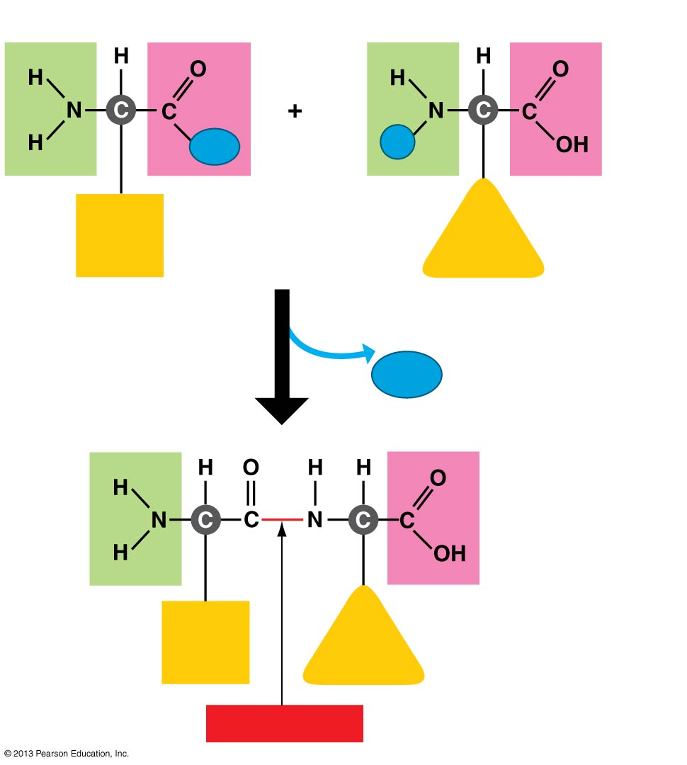
Carboxyl
Amino
OH
H
H₂O
Dehydration reaction
Peptide bond
Notes:
8
Figure 3.17 Joining amino acids (step 2)

Slide 9
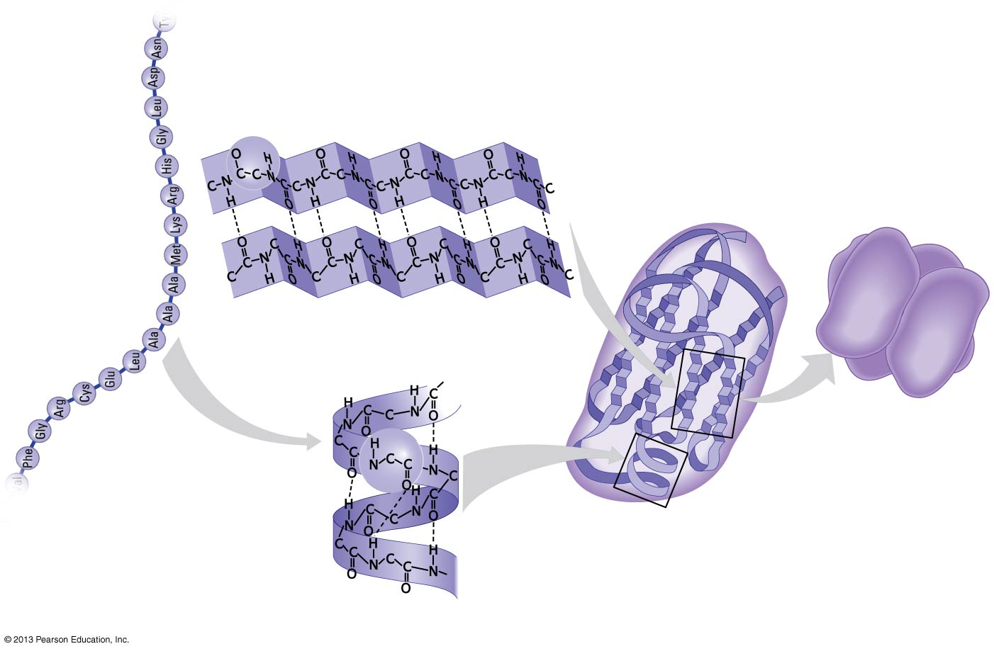
Amino
acids
(b) Secondary structure
(c) Tertiary
structure
(d) Quaternary
structure
(a) Primary
structure
Pleated sheet
A protein with
four polypeptide
subunits
Hydrogen
bond
Polypeptide
Alpha helix
Notes:
9
Figure 3.20 The four levels of protein structure (step 4)

Slide 10
Protein Shape
A protein’s three-dimensional shape
typically recognizes and binds to another molecule and
enables the protein to carry out its specific function in a cell.
Notes:
10
Student Misconceptions and Concerns
1. The abstract nature of chemistry can be discouraging to many students. Consider starting out this section of the lecture by examining the chemical groups on a food nutrition label. Candy bars with peanuts are particularly useful as they contain significant amounts of all three sources of calories (carbohydrates, proteins, and lipids). 2. Students might struggle to extrapolate the properties of lipids to their roles in an organism. Ducks float because their feathers repel water instead of attracting it. Hair on your head remains flexible because of oils produced in your scalp. Examples such as these help connect the abstract properties of lipids to concrete examples in our world. 3. The functional significance of protein shape is an abstract molecular example of form and function relationships, which might be new to some students. The binding of an enzyme to its substrate is a type of molecular handshake, which permits specific interactions. To help students think about form and function relationships, share some concrete analogies in their lives—perhaps flathead and Phillips screwdrivers that match the proper type of screws or the fit of a hand into a glove. 4. The evolution of lactose tolerance within human groups in East Africa does not represent a deliberate decision, yet this evolutionary change appears logical. Many students perceive adaptations as deliberate events with purpose. As students develop a better understanding of the mechanisms of evolution, it will be important to point out that mutations arise by chance, with the culling hand of natural selection favoring traits that convey an advantage. Organisms cannot plan evolutionary change.
Teaching Tips
1. Consider reinforcing the three main sources of calories with food items that clearly represent each group. Bring clear examples to class as visual references; for example, a can of Coke or a bag of sugar for carbohydrates, a tub of margarine for lipids, and some beef jerky for protein (although some fat and carbohydrates might also be included). 2. If your lectures will eventually include details of glycolysis and aerobic respiration, this is a good point to introduce the basic concepts of glucose as fuel. Just introducing this conceptual formula might help: eating glucose + breathing in oxygen (yields) water + usable energy (used to build ATP) + heat + exhaled CO₂. 3. The section about our use of sugars may be of considerable interest to your students, who might not be expecting much interest in a lecture about organic chemistry. Consider an assignment for each student to bring to class a product label indicating high-fructose corn syrup (HFCS) as an ingredient. 4. Learning the definitions of word roots is invaluable when learning science. Learning the meaning of the prefix word roots “mono” (one), “di” (two), and “poly” (many) helps to distinguish the structures of various carbohydrates. 5. Consider an assignment for students to find reliable sources that discuss high sugar consumption in the modern diet. The key, of course, is in the quality of the resource. Consider narrowing down the categories to certain nonprofit health organizations (American Cancer Society, American Heart Association, and the like) and peer-reviewed journals. 6. A simple exercise demonstrates the enzymatic breakdown of starches into sugars. If students place an unsalted cracker in their mouths, holding it in their mouths while it mixes well with saliva, they might soon notice that a sweeter taste begins to emerge. The salivary enzyme amylase begins the digestion of starches into disaccharides, which may be degraded further by other enzymes. These disaccharides are the source of the sweet taste. 7. The cellophane wrap often used to package foods is a biodegradable material derived from cellulose. Consider challenging students to create a list of other cellulose-derived products (such as paper). 8. An adult human may store about a half of a kilogram of glycogen in the liver and muscles of the body, depending on recent dietary habits. A person who begins dieting might soon notice an immediate weight loss of 2–4 pounds (1–2 kilograms) over several days, reflecting reductions in stored glycogen, water, and intestinal contents (among other factors). 9. Another simple demonstration can illustrate hydrophobic and hydrophilic substances. In front of the class, mix colored water and a yellow oil (corn or canola oil work well). Shake up the mixture and then watch as the two separate. (You may have a mixture already made that remains separated; however, the dyes may bleed between the oil and the water.) 10. Margarine in stores commonly comes in liquid squeeze containers, in tubs, and in sticks. These forms reflect increasing amounts of hydrogenation, gradually increasing the stiffness from a liquid, to a firmer spread, to a firm stick of margarine. As noted in the text, recent studies have suggested that unsaturated oils become increasingly unhealthy as they are hydrogenated. Perhaps your students can find references to this correlation on the Internet. 11. Many analogies relate to students the diversity of proteins that can be made from just 20 amino acids. The authors note that our language uses combinations of 26 letters to form words. Proteins are much longer “words”, creating even more diversity. Another analogy is to trains. This builds on the earlier analogy when polymers were introduced. Imagine making different trains about 100 cars long, using any combination of 20 types of railroad cars. Mathematically, the number of possible trains is 20¹⁰⁰, a number beyond imagination. 12. The authors note that the difference between a polypeptide and a protein is analogous to the relationship between a long strand of yarn and a sweater knitted from yarn. Proteins are clearly more complex! 13. Most cooking results in changes in the texture and color of a food. The brown color of a steak is the product of the denaturation of proteins. Fixatives such as formalin also denature proteins and cause color changes. Students who have dissected vertebrates will realize that the brown color of the muscles makes it look as if the animal has been cooked. 14. Consider this assignment to wrap up the presence of organic molecules in our diets. Have students working individually or in small groups analyze a food label listing the components of a McDonald’s Big Mac. Note the most abundant organic molecule class (perhaps by weight) found in each component. 15. The “NA” in DNA and RNA represents ‘nucleic acid”. Students often do not make this association without assistance.

Slide 11
Applications of protein engineering
Medicine
Insulin, growth factors, antibodies…
Industry
Enzymes
Cellulase: alcohol and glucose making
Glucose isomerase: manufacture of high-fructose syrups
Lactase: hydrolysis of lactose
Lipase: cheese making, preparation of flavorings
Notes:
11
Student Misconceptions and Concerns
1. The abstract nature of chemistry can be discouraging to many students. Consider starting out this section of the lecture by examining the chemical groups on a food nutrition label. Candy bars with peanuts are particularly useful as they contain significant amounts of all three sources of calories (carbohydrates, proteins, and lipids). 2. Students might struggle to extrapolate the properties of lipids to their roles in an organism. Ducks float because their feathers repel water instead of attracting it. Hair on your head remains flexible because of oils produced in your scalp. Examples such as these help connect the abstract properties of lipids to concrete examples in our world. 3. The functional significance of protein shape is an abstract molecular example of form and function relationships, which might be new to some students. The binding of an enzyme to its substrate is a type of molecular handshake, which permits specific interactions. To help students think about form and function relationships, share some concrete analogies in their lives—perhaps flathead and Phillips screwdrivers that match the proper type of screws or the fit of a hand into a glove. 4. The evolution of lactose tolerance within human groups in East Africa does not represent a deliberate decision, yet this evolutionary change appears logical. Many students perceive adaptations as deliberate events with purpose. As students develop a better understanding of the mechanisms of evolution, it will be important to point out that mutations arise by chance, with the culling hand of natural selection favoring traits that convey an advantage. Organisms cannot plan evolutionary change.
Teaching Tips
1. Consider reinforcing the three main sources of calories with food items that clearly represent each group. Bring clear examples to class as visual references; for example, a can of Coke or a bag of sugar for carbohydrates, a tub of margarine for lipids, and some beef jerky for protein (although some fat and carbohydrates might also be included). 2. If your lectures will eventually include details of glycolysis and aerobic respiration, this is a good point to introduce the basic concepts of glucose as fuel. Just introducing this conceptual formula might help: eating glucose + breathing in oxygen (yields) water + usable energy (used to build ATP) + heat + exhaled CO₂. 3. The section about our use of sugars may be of considerable interest to your students, who might not be expecting much interest in a lecture about organic chemistry. Consider an assignment for each student to bring to class a product label indicating high-fructose corn syrup (HFCS) as an ingredient. 4. Learning the definitions of word roots is invaluable when learning science. Learning the meaning of the prefix word roots “mono” (one), “di” (two), and “poly” (many) helps to distinguish the structures of various carbohydrates. 5. Consider an assignment for students to find reliable sources that discuss high sugar consumption in the modern diet. The key, of course, is in the quality of the resource. Consider narrowing down the categories to certain nonprofit health organizations (American Cancer Society, American Heart Association, and the like) and peer-reviewed journals. 6. A simple exercise demonstrates the enzymatic breakdown of starches into sugars. If students place an unsalted cracker in their mouths, holding it in their mouths while it mixes well with saliva, they might soon notice that a sweeter taste begins to emerge. The salivary enzyme amylase begins the digestion of starches into disaccharides, which may be degraded further by other enzymes. These disaccharides are the source of the sweet taste. 7. The cellophane wrap often used to package foods is a biodegradable material derived from cellulose. Consider challenging students to create a list of other cellulose-derived products (such as paper). 8. An adult human may store about a half of a kilogram of glycogen in the liver and muscles of the body, depending on recent dietary habits. A person who begins dieting might soon notice an immediate weight loss of 2–4 pounds (1–2 kilograms) over several days, reflecting reductions in stored glycogen, water, and intestinal contents (among other factors). 9. Another simple demonstration can illustrate hydrophobic and hydrophilic substances. In front of the class, mix colored water and a yellow oil (corn or canola oil work well). Shake up the mixture and then watch as the two separate. (You may have a mixture already made that remains separated; however, the dyes may bleed between the oil and the water.) 10. Margarine in stores commonly comes in liquid squeeze containers, in tubs, and in sticks. These forms reflect increasing amounts of hydrogenation, gradually increasing the stiffness from a liquid, to a firmer spread, to a firm stick of margarine. As noted in the text, recent studies have suggested that unsaturated oils become increasingly unhealthy as they are hydrogenated. Perhaps your students can find references to this correlation on the Internet. 11. Many analogies relate to students the diversity of proteins that can be made from just 20 amino acids. The authors note that our language uses combinations of 26 letters to form words. Proteins are much longer “words”, creating even more diversity. Another analogy is to trains. This builds on the earlier analogy when polymers were introduced. Imagine making different trains about 100 cars long, using any combination of 20 types of railroad cars. Mathematically, the number of possible trains is 20¹⁰⁰, a number beyond imagination. 12. The authors note that the difference between a polypeptide and a protein is analogous to the relationship between a long strand of yarn and a sweater knitted from yarn. Proteins are clearly more complex! 13. Most cooking results in changes in the texture and color of a food. The brown color of a steak is the product of the denaturation of proteins. Fixatives such as formalin also denature proteins and cause color changes. Students who have dissected vertebrates will realize that the brown color of the muscles makes it look as if the animal has been cooked. 14. Consider this assignment to wrap up the presence of organic molecules in our diets. Have students working individually or in small groups analyze a food label listing the components of a McDonald’s Big Mac. Note the most abundant organic molecule class (perhaps by weight) found in each component. 15. The “NA” in DNA and RNA represents ‘nucleic acid”. Students often do not make this association without assistance.

Slide 12
Applications of protein engineering
1. Detergents (> 40 years of experience)
lower laundry wash temperatures increase the need for adding enzymes.
remove 95% of a stain, how about the remaining 5% ?
“ total cleaning” concept
“ white becomes whiter!!”
• Detergent enzymes : (hydrolases)
-- proteases : a. alkaline optimum, pH 8-11
b. bleach stable
c. low wash temp. (10-20 °C)
-- lipases
-- amylases
-- cellulases (clean, overall fabric care, and color maintenance)
Notes:
12
Student Misconceptions and Concerns
1. The abstract nature of chemistry can be discouraging to many students. Consider starting out this section of the lecture by examining the chemical groups on a food nutrition label. Candy bars with peanuts are particularly useful as they contain significant amounts of all three sources of calories (carbohydrates, proteins, and lipids). 2. Students might struggle to extrapolate the properties of lipids to their roles in an organism. Ducks float because their feathers repel water instead of attracting it. Hair on your head remains flexible because of oils produced in your scalp. Examples such as these help connect the abstract properties of lipids to concrete examples in our world. 3. The functional significance of protein shape is an abstract molecular example of form and function relationships, which might be new to some students. The binding of an enzyme to its substrate is a type of molecular handshake, which permits specific interactions. To help students think about form and function relationships, share some concrete analogies in their lives—perhaps flathead and Phillips screwdrivers that match the proper type of screws or the fit of a hand into a glove. 4. The evolution of lactose tolerance within human groups in East Africa does not represent a deliberate decision, yet this evolutionary change appears logical. Many students perceive adaptations as deliberate events with purpose. As students develop a better understanding of the mechanisms of evolution, it will be important to point out that mutations arise by chance, with the culling hand of natural selection favoring traits that convey an advantage. Organisms cannot plan evolutionary change.
Teaching Tips
1. Consider reinforcing the three main sources of calories with food items that clearly represent each group. Bring clear examples to class as visual references; for example, a can of Coke or a bag of sugar for carbohydrates, a tub of margarine for lipids, and some beef jerky for protein (although some fat and carbohydrates might also be included). 2. If your lectures will eventually include details of glycolysis and aerobic respiration, this is a good point to introduce the basic concepts of glucose as fuel. Just introducing this conceptual formula might help: eating glucose + breathing in oxygen (yields) water + usable energy (used to build ATP) + heat + exhaled CO₂. 3. The section about our use of sugars may be of considerable interest to your students, who might not be expecting much interest in a lecture about organic chemistry. Consider an assignment for each student to bring to class a product label indicating high-fructose corn syrup (HFCS) as an ingredient. 4. Learning the definitions of word roots is invaluable when learning science. Learning the meaning of the prefix word roots “mono” (one), “di” (two), and “poly” (many) helps to distinguish the structures of various carbohydrates. 5. Consider an assignment for students to find reliable sources that discuss high sugar consumption in the modern diet. The key, of course, is in the quality of the resource. Consider narrowing down the categories to certain nonprofit health organizations (American Cancer Society, American Heart Association, and the like) and peer-reviewed journals. 6. A simple exercise demonstrates the enzymatic breakdown of starches into sugars. If students place an unsalted cracker in their mouths, holding it in their mouths while it mixes well with saliva, they might soon notice that a sweeter taste begins to emerge. The salivary enzyme amylase begins the digestion of starches into disaccharides, which may be degraded further by other enzymes. These disaccharides are the source of the sweet taste. 7. The cellophane wrap often used to package foods is a biodegradable material derived from cellulose. Consider challenging students to create a list of other cellulose-derived products (such as paper). 8. An adult human may store about a half of a kilogram of glycogen in the liver and muscles of the body, depending on recent dietary habits. A person who begins dieting might soon notice an immediate weight loss of 2–4 pounds (1–2 kilograms) over several days, reflecting reductions in stored glycogen, water, and intestinal contents (among other factors). 9. Another simple demonstration can illustrate hydrophobic and hydrophilic substances. In front of the class, mix colored water and a yellow oil (corn or canola oil work well). Shake up the mixture and then watch as the two separate. (You may have a mixture already made that remains separated; however, the dyes may bleed between the oil and the water.) 10. Margarine in stores commonly comes in liquid squeeze containers, in tubs, and in sticks. These forms reflect increasing amounts of hydrogenation, gradually increasing the stiffness from a liquid, to a firmer spread, to a firm stick of margarine. As noted in the text, recent studies have suggested that unsaturated oils become increasingly unhealthy as they are hydrogenated. Perhaps your students can find references to this correlation on the Internet. 11. Many analogies relate to students the diversity of proteins that can be made from just 20 amino acids. The authors note that our language uses combinations of 26 letters to form words. Proteins are much longer “words”, creating even more diversity. Another analogy is to trains. This builds on the earlier analogy when polymers were introduced. Imagine making different trains about 100 cars long, using any combination of 20 types of railroad cars. Mathematically, the number of possible trains is 20¹⁰⁰, a number beyond imagination. 12. The authors note that the difference between a polypeptide and a protein is analogous to the relationship between a long strand of yarn and a sweater knitted from yarn. Proteins are clearly more complex! 13. Most cooking results in changes in the texture and color of a food. The brown color of a steak is the product of the denaturation of proteins. Fixatives such as formalin also denature proteins and cause color changes. Students who have dissected vertebrates will realize that the brown color of the muscles makes it look as if the animal has been cooked. 14. Consider this assignment to wrap up the presence of organic molecules in our diets. Have students working individually or in small groups analyze a food label listing the components of a McDonald’s Big Mac. Note the most abundant organic molecule class (perhaps by weight) found in each component. 15. The “NA” in DNA and RNA represents ‘nucleic acid”. Students often do not make this association without assistance.

Slide 13
Applications of protein engineering
2. Baking
• Flour consists of gluten, starch, non-starch polysaccharides, lipids and
trace amounts of minerals.
• Optimize a combination of lower dosages of enzymes to achieve
optimum dough consistency, stability, and bread quality.
Fungal alpha-amylase:
Maximizes the fermentation process to obtain
An even crumb structure and a high loaf
volume
Glucose oxidase:
Oxidizes free sulphydryl groups in gluten to
smaller crumb cells and a silkier texture elastic
Lipase:
Dough conditioning by producing more
uniform, make weak dough stronger and
whiter crumb color.
Lipoxygenase:
Bleaching and strengthening dough
Xylanase:
Dough conditioning, Easier dough handling and improved crumb structure
Protease:
Weakens the gluten to provide the plastic properties required in dough for biscuits
Notes:
13
Student Misconceptions and Concerns
1. The abstract nature of chemistry can be discouraging to many students. Consider starting out this section of the lecture by examining the chemical groups on a food nutrition label. Candy bars with peanuts are particularly useful as they contain significant amounts of all three sources of calories (carbohydrates, proteins, and lipids). 2. Students might struggle to extrapolate the properties of lipids to their roles in an organism. Ducks float because their feathers repel water instead of attracting it. Hair on your head remains flexible because of oils produced in your scalp. Examples such as these help connect the abstract properties of lipids to concrete examples in our world. 3. The functional significance of protein shape is an abstract molecular example of form and function relationships, which might be new to some students. The binding of an enzyme to its substrate is a type of molecular handshake, which permits specific interactions. To help students think about form and function relationships, share some concrete analogies in their lives—perhaps flathead and Phillips screwdrivers that match the proper type of screws or the fit of a hand into a glove. 4. The evolution of lactose tolerance within human groups in East Africa does not represent a deliberate decision, yet this evolutionary change appears logical. Many students perceive adaptations as deliberate events with purpose. As students develop a better understanding of the mechanisms of evolution, it will be important to point out that mutations arise by chance, with the culling hand of natural selection favoring traits that convey an advantage. Organisms cannot plan evolutionary change.
Teaching Tips
1. Consider reinforcing the three main sources of calories with food items that clearly represent each group. Bring clear examples to class as visual references; for example, a can of Coke or a bag of sugar for carbohydrates, a tub of margarine for lipids, and some beef jerky for protein (although some fat and carbohydrates might also be included). 2. If your lectures will eventually include details of glycolysis and aerobic respiration, this is a good point to introduce the basic concepts of glucose as fuel. Just introducing this conceptual formula might help: eating glucose + breathing in oxygen (yields) water + usable energy (used to build ATP) + heat + exhaled CO₂. 3. The section about our use of sugars may be of considerable interest to your students, who might not be expecting much interest in a lecture about organic chemistry. Consider an assignment for each student to bring to class a product label indicating high-fructose corn syrup (HFCS) as an ingredient. 4. Learning the definitions of word roots is invaluable when learning science. Learning the meaning of the prefix word roots “mono” (one), “di” (two), and “poly” (many) helps to distinguish the structures of various carbohydrates. 5. Consider an assignment for students to find reliable sources that discuss high sugar consumption in the modern diet. The key, of course, is in the quality of the resource. Consider narrowing down the categories to certain nonprofit health organizations (American Cancer Society, American Heart Association, and the like) and peer-reviewed journals. 6. A simple exercise demonstrates the enzymatic breakdown of starches into sugars. If students place an unsalted cracker in their mouths, holding it in their mouths while it mixes well with saliva, they might soon notice that a sweeter taste begins to emerge. The salivary enzyme amylase begins the digestion of starches into disaccharides, which may be degraded further by other enzymes. These disaccharides are the source of the sweet taste. 7. The cellophane wrap often used to package foods is a biodegradable material derived from cellulose. Consider challenging students to create a list of other cellulose-derived products (such as paper). 8. An adult human may store about a half of a kilogram of glycogen in the liver and muscles of the body, depending on recent dietary habits. A person who begins dieting might soon notice an immediate weight loss of 2–4 pounds (1–2 kilograms) over several days, reflecting reductions in stored glycogen, water, and intestinal contents (among other factors). 9. Another simple demonstration can illustrate hydrophobic and hydrophilic substances. In front of the class, mix colored water and a yellow oil (corn or canola oil work well). Shake up the mixture and then watch as the two separate. (You may have a mixture already made that remains separated; however, the dyes may bleed between the oil and the water.) 10. Margarine in stores commonly comes in liquid squeeze containers, in tubs, and in sticks. These forms reflect increasing amounts of hydrogenation, gradually increasing the stiffness from a liquid, to a firmer spread, to a firm stick of margarine. As noted in the text, recent studies have suggested that unsaturated oils become increasingly unhealthy as they are hydrogenated. Perhaps your students can find references to this correlation on the Internet. 11. Many analogies relate to students the diversity of proteins that can be made from just 20 amino acids. The authors note that our language uses combinations of 26 letters to form words. Proteins are much longer “words”, creating even more diversity. Another analogy is to trains. This builds on the earlier analogy when polymers were introduced. Imagine making different trains about 100 cars long, using any combination of 20 types of railroad cars. Mathematically, the number of possible trains is 20¹⁰⁰, a number beyond imagination. 12. The authors note that the difference between a polypeptide and a protein is analogous to the relationship between a long strand of yarn and a sweater knitted from yarn. Proteins are clearly more complex! 13. Most cooking results in changes in the texture and color of a food. The brown color of a steak is the product of the denaturation of proteins. Fixatives such as formalin also denature proteins and cause color changes. Students who have dissected vertebrates will realize that the brown color of the muscles makes it look as if the animal has been cooked. 14. Consider this assignment to wrap up the presence of organic molecules in our diets. Have students working individually or in small groups analyze a food label listing the components of a McDonald’s Big Mac. Note the most abundant organic molecule class (perhaps by weight) found in each component. 15. The “NA” in DNA and RNA represents ‘nucleic acid”. Students often do not make this association without assistance.

Slide 14
Strategies of protein engineering research
How to improve or change the properties of proteins?
Notes:
14
Student Misconceptions and Concerns
1. The abstract nature of chemistry can be discouraging to many students. Consider starting out this section of the lecture by examining the chemical groups on a food nutrition label. Candy bars with peanuts are particularly useful as they contain significant amounts of all three sources of calories (carbohydrates, proteins, and lipids). 2. Students might struggle to extrapolate the properties of lipids to their roles in an organism. Ducks float because their feathers repel water instead of attracting it. Hair on your head remains flexible because of oils produced in your scalp. Examples such as these help connect the abstract properties of lipids to concrete examples in our world. 3. The functional significance of protein shape is an abstract molecular example of form and function relationships, which might be new to some students. The binding of an enzyme to its substrate is a type of molecular handshake, which permits specific interactions. To help students think about form and function relationships, share some concrete analogies in their lives—perhaps flathead and Phillips screwdrivers that match the proper type of screws or the fit of a hand into a glove. 4. The evolution of lactose tolerance within human groups in East Africa does not represent a deliberate decision, yet this evolutionary change appears logical. Many students perceive adaptations as deliberate events with purpose. As students develop a better understanding of the mechanisms of evolution, it will be important to point out that mutations arise by chance, with the culling hand of natural selection favoring traits that convey an advantage. Organisms cannot plan evolutionary change.
Teaching Tips
1. Consider reinforcing the three main sources of calories with food items that clearly represent each group. Bring clear examples to class as visual references; for example, a can of Coke or a bag of sugar for carbohydrates, a tub of margarine for lipids, and some beef jerky for protein (although some fat and carbohydrates might also be included). 2. If your lectures will eventually include details of glycolysis and aerobic respiration, this is a good point to introduce the basic concepts of glucose as fuel. Just introducing this conceptual formula might help: eating glucose + breathing in oxygen (yields) water + usable energy (used to build ATP) + heat + exhaled CO₂. 3. The section about our use of sugars may be of considerable interest to your students, who might not be expecting much interest in a lecture about organic chemistry. Consider an assignment for each student to bring to class a product label indicating high-fructose corn syrup (HFCS) as an ingredient. 4. Learning the definitions of word roots is invaluable when learning science. Learning the meaning of the prefix word roots “mono” (one), “di” (two), and “poly” (many) helps to distinguish the structures of various carbohydrates. 5. Consider an assignment for students to find reliable sources that discuss high sugar consumption in the modern diet. The key, of course, is in the quality of the resource. Consider narrowing down the categories to certain nonprofit health organizations (American Cancer Society, American Heart Association, and the like) and peer-reviewed journals. 6. A simple exercise demonstrates the enzymatic breakdown of starches into sugars. If students place an unsalted cracker in their mouths, holding it in their mouths while it mixes well with saliva, they might soon notice that a sweeter taste begins to emerge. The salivary enzyme amylase begins the digestion of starches into disaccharides, which may be degraded further by other enzymes. These disaccharides are the source of the sweet taste. 7. The cellophane wrap often used to package foods is a biodegradable material derived from cellulose. Consider challenging students to create a list of other cellulose-derived products (such as paper). 8. An adult human may store about a half of a kilogram of glycogen in the liver and muscles of the body, depending on recent dietary habits. A person who begins dieting might soon notice an immediate weight loss of 2–4 pounds (1–2 kilograms) over several days, reflecting reductions in stored glycogen, water, and intestinal contents (among other factors). 9. Another simple demonstration can illustrate hydrophobic and hydrophilic substances. In front of the class, mix colored water and a yellow oil (corn or canola oil work well). Shake up the mixture and then watch as the two separate. (You may have a mixture already made that remains separated; however, the dyes may bleed between the oil and the water.) 10. Margarine in stores commonly comes in liquid squeeze containers, in tubs, and in sticks. These forms reflect increasing amounts of hydrogenation, gradually increasing the stiffness from a liquid, to a firmer spread, to a firm stick of margarine. As noted in the text, recent studies have suggested that unsaturated oils become increasingly unhealthy as they are hydrogenated. Perhaps your students can find references to this correlation on the Internet. 11. Many analogies relate to students the diversity of proteins that can be made from just 20 amino acids. The authors note that our language uses combinations of 26 letters to form words. Proteins are much longer “words”, creating even more diversity. Another analogy is to trains. This builds on the earlier analogy when polymers were introduced. Imagine making different trains about 100 cars long, using any combination of 20 types of railroad cars. Mathematically, the number of possible trains is 20¹⁰⁰, a number beyond imagination. 12. The authors note that the difference between a polypeptide and a protein is analogous to the relationship between a long strand of yarn and a sweater knitted from yarn. Proteins are clearly more complex! 13. Most cooking results in changes in the texture and color of a food. The brown color of a steak is the product of the denaturation of proteins. Fixatives such as formalin also denature proteins and cause color changes. Students who have dissected vertebrates will realize that the brown color of the muscles makes it look as if the animal has been cooked. 14. Consider this assignment to wrap up the presence of organic molecules in our diets. Have students working individually or in small groups analyze a food label listing the components of a McDonald’s Big Mac. Note the most abundant organic molecule class (perhaps by weight) found in each component. 15. The “NA” in DNA and RNA represents ‘nucleic acid”. Students often do not make this association without assistance.

Slide 15
Strategies of protein engineering research
Central Dogma: Information flow in cells
transcription
translation
DNA
RNA
Protein
replication

Slide 16

Second base of RNA codon
U
C
A
G
UUU UUC
UCU UCC UCA UCG
UAU UAC
UGU UGC
U C A G
Phenylalanine
(Phe)
Tyrosine
(Tyr)
Cysteine
(Cys)
U
Serine
(Ser)
UUA UUG
UAA
Stop
UGA
Stop
Leucine
(Leu)
UAG
UGG
Stop
Tryptophan (Trp)
CUU CUC CUA CUG
CCU CCC CCA CCG
CAU CAC
CGU CGC CGA CGG
U C A G
Histidine
(His)
C
Leucine
(Leu)
Proline
(Pro)
Arginine
(Arg)
CAA CAG
Glutamine
(Gln)
Third base of RNA codon
First base of RNA codon
AUU AUC AUA
ACU ACC ACA ACG
AAU AAC
AGU AGC
U C A G
Asparagine
(Asn)
Serine
(Ser)
Isoleucine
(Ile)
A
Threonine
(Thr)
AAA AAG
AGA AGG
Lysine
(Lys)
Arginine
(Arg)
AUG
Met or start
GUU GUC GUA GUG
GCU GCC GCA GCG
GAU GAC
GGU GGC
U C A G
Aspartic
acid (Asp)
G
Valine
(Val)
Alanine
(Ala)
Glycine
(Gly)
GAA GAG
GGA GGG
Glutamic
acid (Glu)
Notes:
Figure 10.11 The dictionary of the genetic code, listed by RNA codons

Slide 17
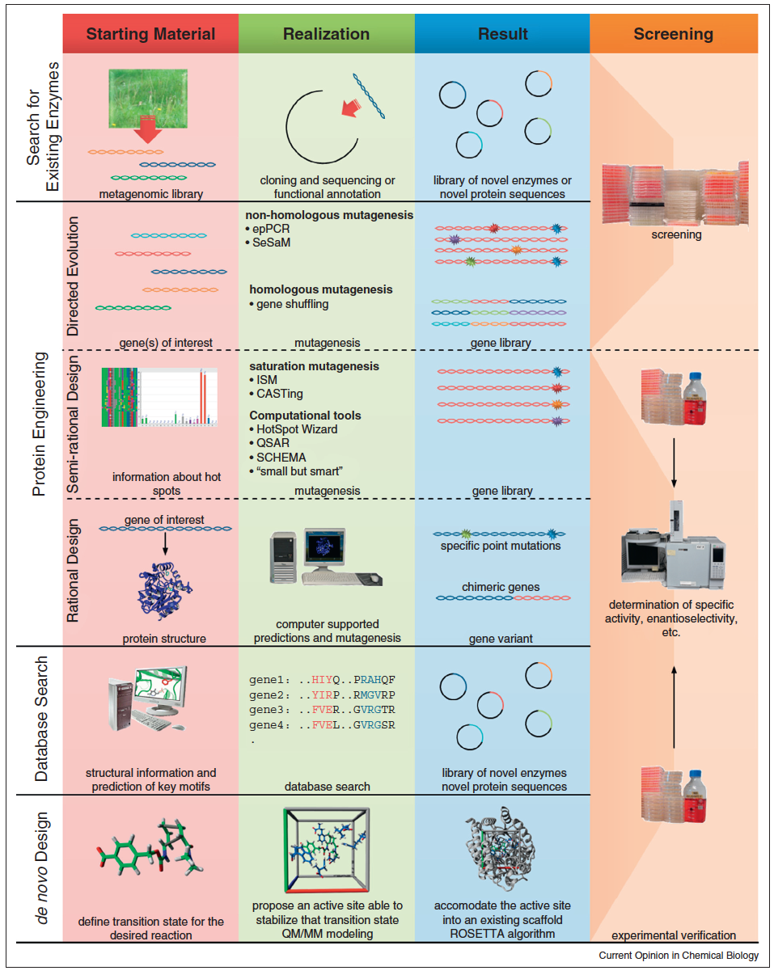
Overview of concepts used to identify or create enzymes with desired properties

Slide 18
Directed Evolution – Random mutagenesis
-> based on the process of natural evolution
- NO structural information required
- NO understanding of the mechanism required
General Procedure:
Generation of genetic diversity
⇒ Random mutagenesis
(Error-prone PCR and DNA shuffling)
Identification of successful variants
⇒ Screening and seletion

Slide 19
Rational Protein Design
⇒ Site –directed mutagenesis !!!
Requirements:
-> Knowledge of sequence and preferable Structure
(active site,….)
-> Understanding of mechanism
(knowledge about structure – function relationship)
-> Identification of cofactors……..

Slide 20
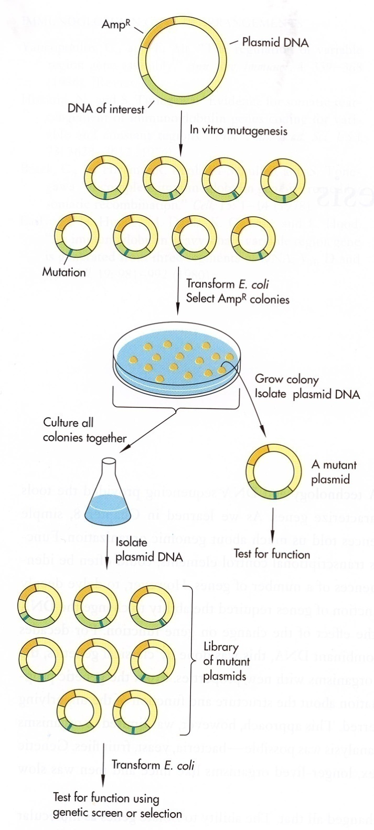
General strategy for directed mutagenesis
Requirements:
DNA of interest (gene or promoter) must be cloned
Expression system must be available -> for testing phenotypic change

Slide 21
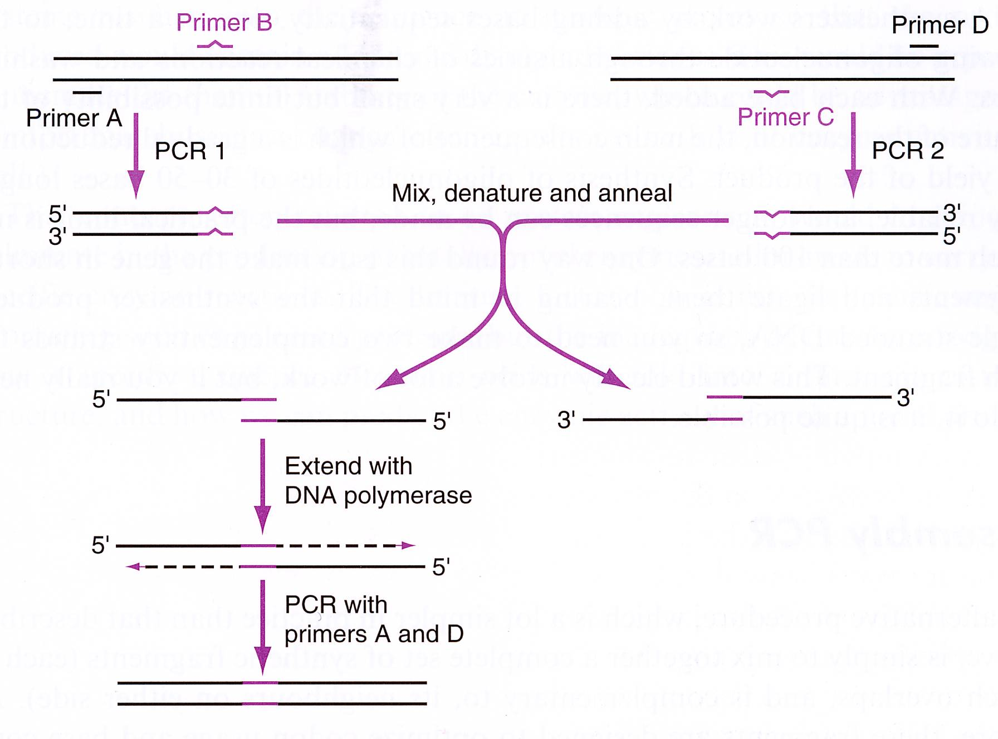
Site-directed mutagenesis methods – PCR based
1. Over-lapping PCR

Slide 22
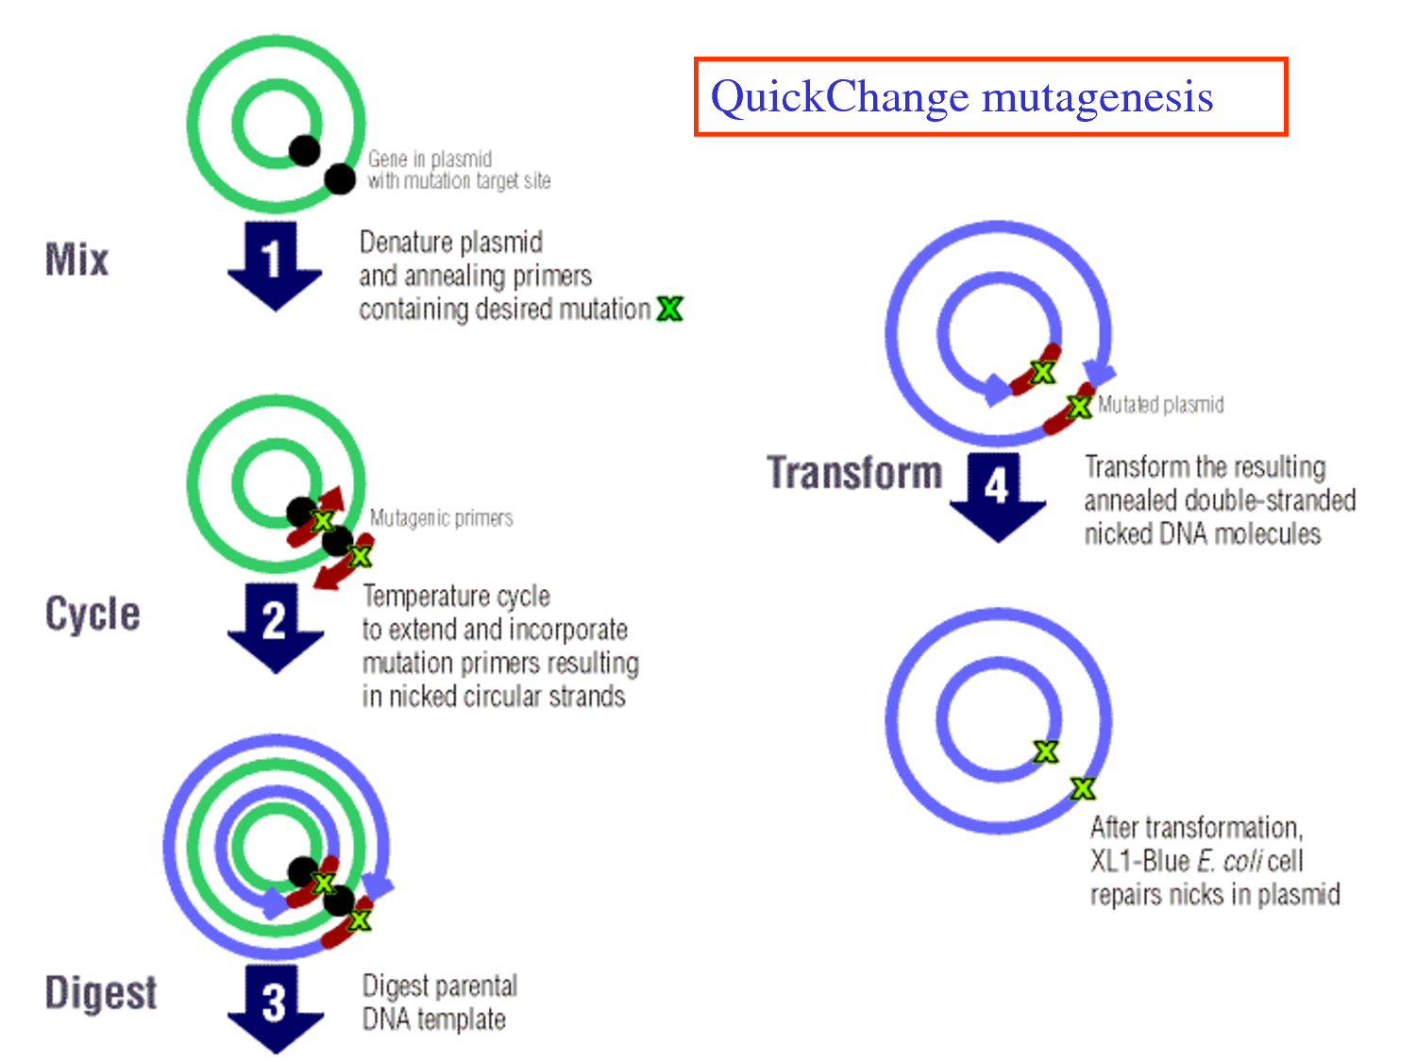
Site-directed mutagenesis methods – PCR based
2. Quick-change and related methods

Slide 23
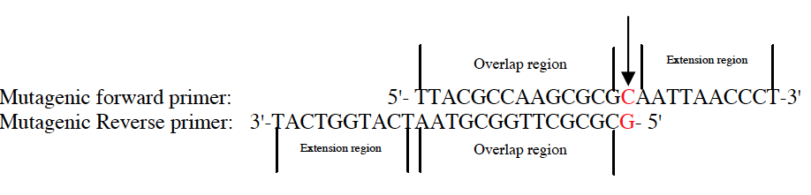
Site-directed mutagenesis methods – PCR based
2. Quick-change and related methods
Genetailor

Slide 24
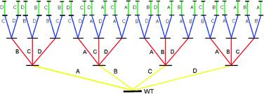
Site-directed mutagenesis methods – PCR based
3. Iterative saturated mutation

Slide 25
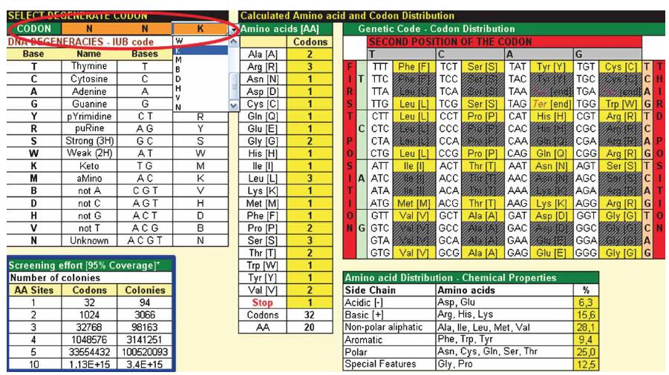
Site-directed mutagenesis methods – PCR based
3. Iterative saturated mutation

Slide 26
De novo design
“Knowledge-based protein design”
A highly challenging approach, offering the broadest possibility for new structure
• To find the best amino acid sequence to ensure folding in a selected structure (α-helical bundle or α/β-barrel) VS structure prediction
• To design and construct a synthetic protein using the information on the 3-D structures of natural protein accumulates and folding rules of proteins
Methionine: prefers rigid segments, the central part of helical segments, and buried regions of natural proteins
Threonine: prefers flexible segments
Lysine: a good helix former and prefers at the C-terminal, etc.
Leucine: stabilizes helices, prefers buried regions, and is usually found in the middle positions in a helix

Slide 27
De novo design
Questions to be addressed:
Target structure
Function-structure relationship
Compared to direction evolution
Often based on known structure, novel folds are possible
Sequence space
Structural flexibility
Energy function

Slide 28
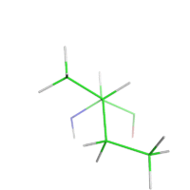
De novo design
Questions to be addressed:
Target structure
Sequence space
Structural flexibility
Side-chain
Main chain (backbone)
Energy function

Slide 29
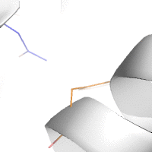
De novo design
Questions to be addressed:
Energy function
Rank and score sequences how well they fold to the target structure
Accurate but simple
Knowledge-based energy functions
Physics-based energy functions (AMBER,
CHARMM, decomposable)
Statistical potentials (fast)
Challenges
single sequence vs multi-sequences, Combined, Rosetta
Water

Slide 30
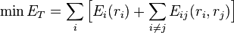
De novo design
Protein design as an optimization problem
Algorithms
Algorithms with mathematical guarantees
Dead-end elimination (DEE)
Branch-and-bound algorithms
Optimization as an integer linear program
Message-passing based approximating to the linear programming dual
Optimization algorithms without guarantees
Monte Carlo and simulated annealing
Faster
Belief propagation for protein design

Slide 31
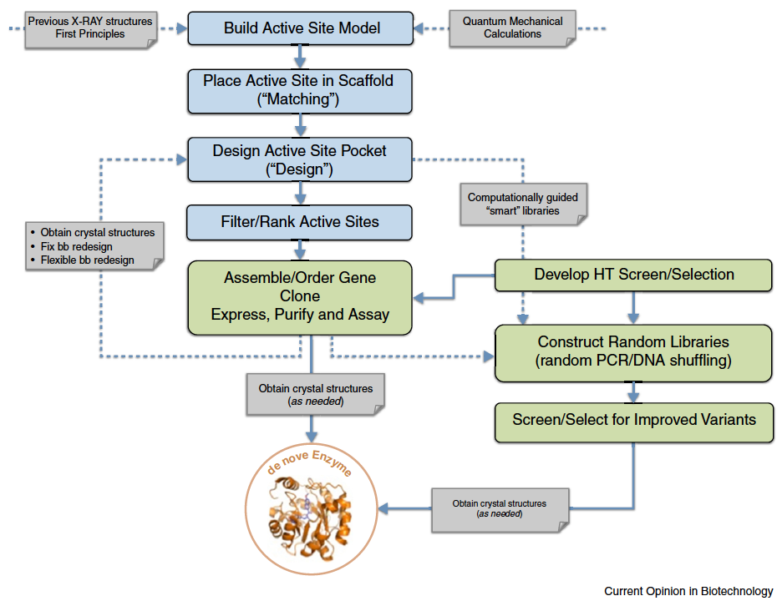
Flowchart of De novo design
de novo computational enzyme design. Zanghellini A.
Curr Opin Biotechnol. 2014 Apr 30;29C:132-138. doi: 10.1016/j.copbio.2014.03.002.

Slide 32
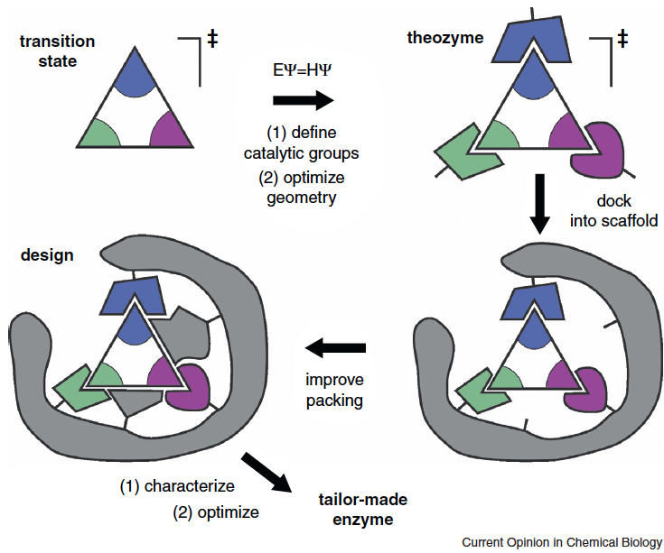
De novo design of enzymes
De novo enzymes by computational design. Kries H, Blomberg R, Hilvert D.
Curr Opin Chem Biol. 2013 Apr;17(2):221-8. doi: 10.1016/j.cbpa.2013.02.012.

Slide 33
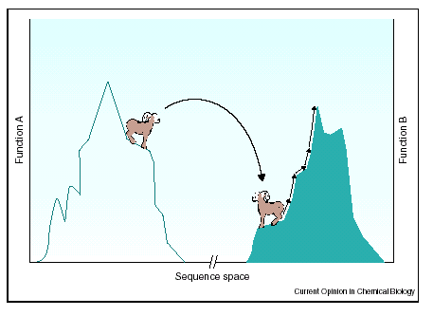
De novo design
To identify sequences and geometries of amino acids that are optimal for stabilizing the backbone geometry.
To develop powerful search algorithms to find optimal solutions

Slide 34
Applications of protein design
What can be engineered in Proteins ?
-> Folding (+Structure):
1. Thermodynamic Stability
(Equilibrium between: Native ⇔ Unfolded state)
2. Thermal and Environmental Stability (Temperature, pH, Solvent, Detergents, Salt …..)

Slide 35
Applications of protein design
What can be engineered in Proteins ?
-> Function:
1. Binding (Interaction of a protein with its surroundings)
How many points are required to bind a molecule with high affinity?
Catalysis (a different form of binding – binding the transition state of a chemical reaction)
Increased binding to the transition state ⇒ increased catalytic rates and enzyme specificity!!!
Requires: Knowledge of the Catalytic Mechanism !!!
-> engineer Kcat and Km

Slide 36
Stability improvement
Factors which contribute to stability:
Hydrophobicity (hydrophobic core)
Electrostatic Interactions:
-> Salt Bridges
-> Hydrogen Bonds
-> Dipole Interactions
Disulfide Bridges
Metal Binding (Metal chelating site)
Reduction of the unfolded state entropy with
X → Pro mutations

Slide 37
Stability improvement
Design of Thermal and Environmental stability:
Stabilization of α-Helix Macrodipoles
Engineer Structural Motifes (like Helix N-Caps)
Introduction of salt bridges
Introduction of residues with higher intrinsic properties for their conformational state (e.g. Ala replacement within a α-Helix)
Introduction of disulfide bridges
Reduction of the unfolded state entropy with
X → Pro mutations

Slide 38
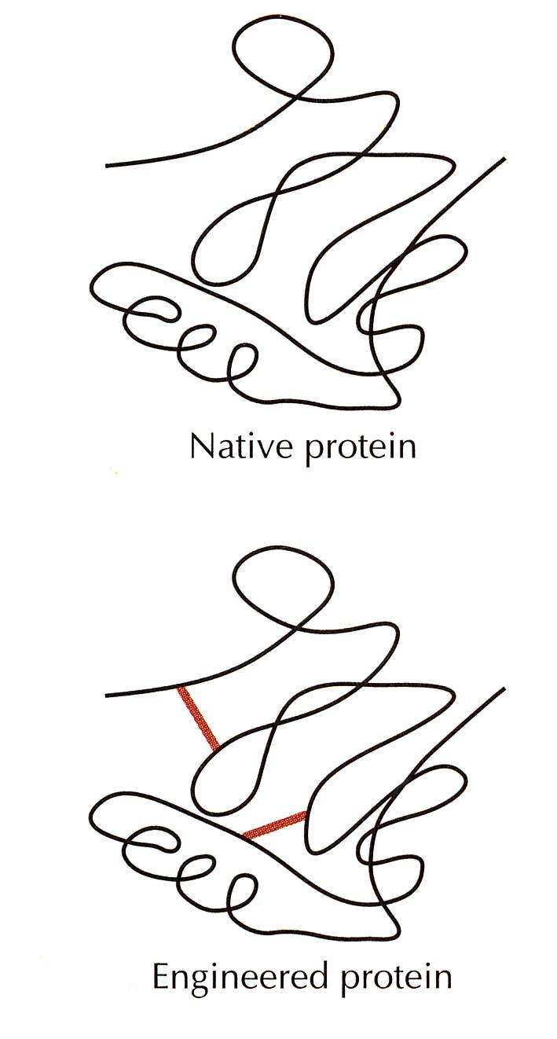
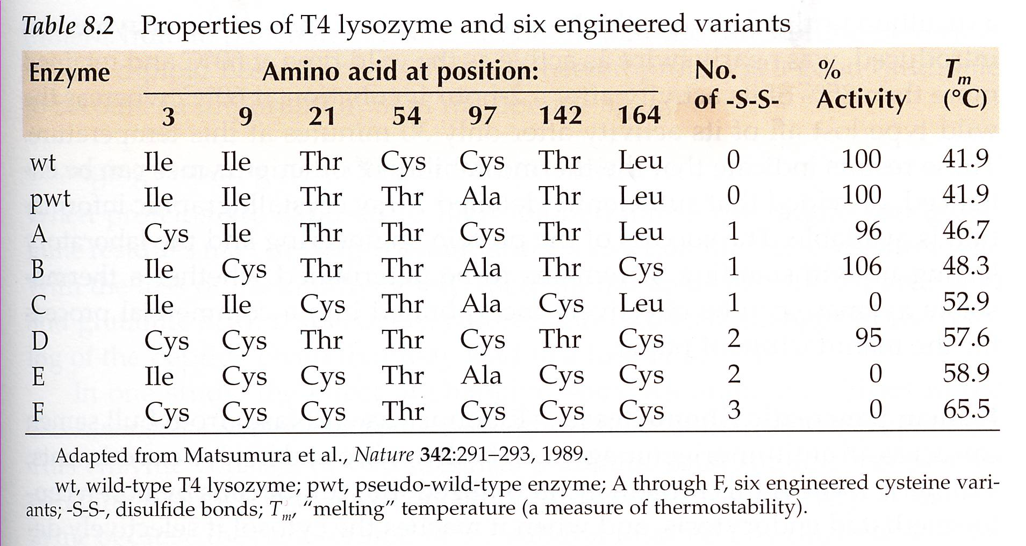
Stability improvement-1
Engineering Stability of Enzymes – T4 lysozyme
-> S-S bonds introduction

Slide 39
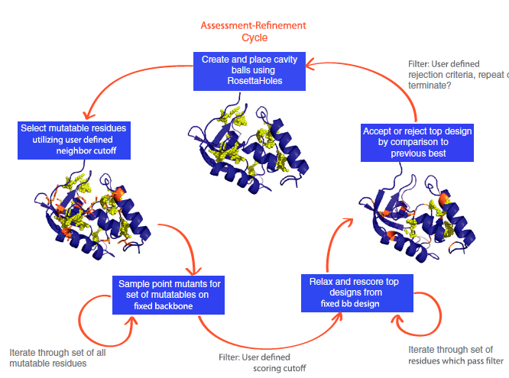
Stability improvement-2
Overview of the Rosettta_{vip} protocol
1.Void identification
2. Mutations to fill the void
3. Optimization (fixed BB)
4. Relaxation of favorable mutations
5. Select and continue
Automated selection of stabilizing mutations in designed and natural proteins. Borgo B, Havranek JJ.
Proc Natl Acad Sci U S A. 2012 Jan 31;109(5):1494-9. doi: 10.1073/pnas.1115172109. Epub 2012 Jan 17.

Slide 40
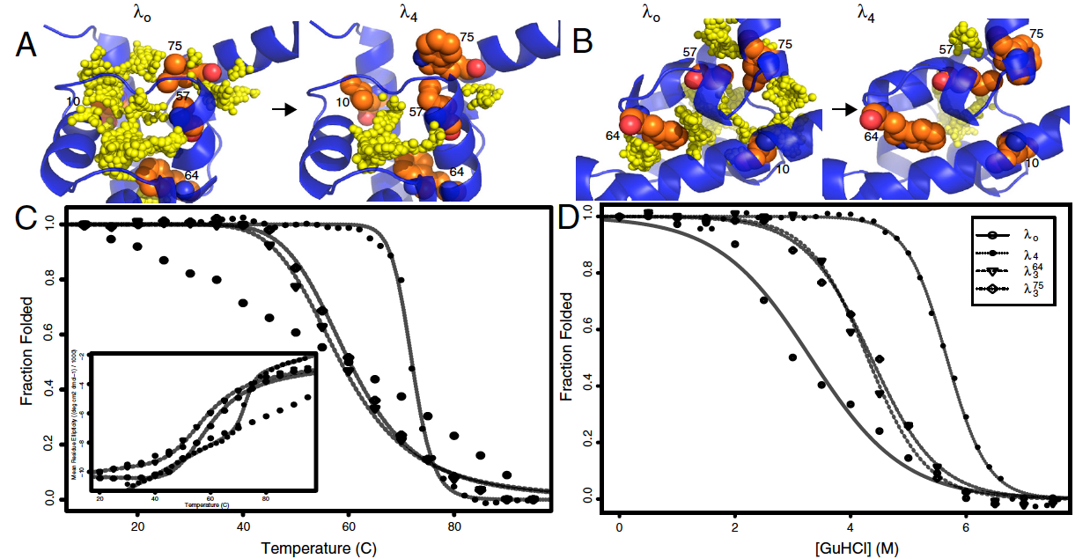
Stability improvement-2
Designed λ repressor by Rosetta_{vip}
4 mutations, reduction of >240Å³, increased stability (thermal and chemical)
Automated selection of stabilizing mutations in designed and natural proteins. Borgo B, Havranek JJ.
Proc Natl Acad Sci U S A. 2012 Jan 31;109(5):1494-9. doi: 10.1073/pnas.1115172109. Epub 2012 Jan 17.

Slide 41
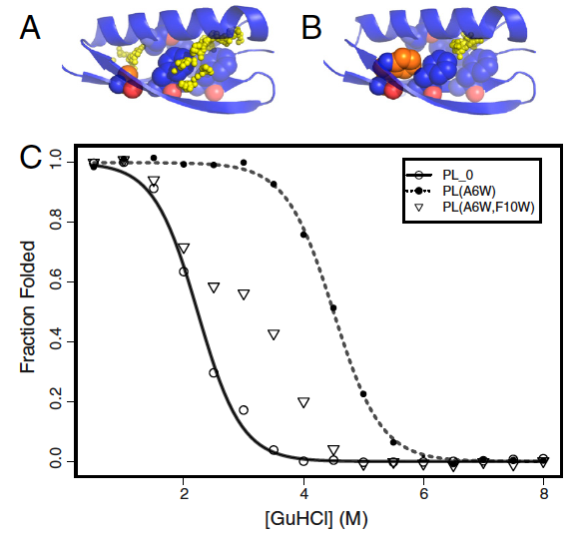
Stability improvement-2
Designed Protein L by Rosetta_{vip}
Two voids identified
Two mutations
Transition between folded and unfolded
False positive
Single mutation
Automated selection of stabilizing mutations in designed and natural proteins. Borgo B, Havranek JJ.
Proc Natl Acad Sci U S A. 2012 Jan 31;109(5):1494-9. doi: 10.1073/pnas.1115172109. Epub 2012 Jan 17.

Slide 42
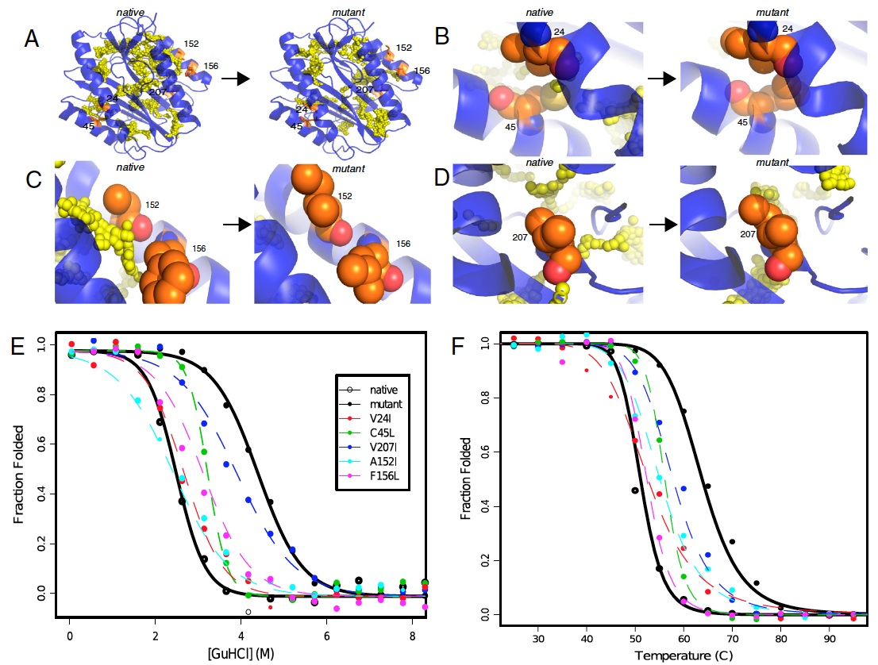
Stability improvement-2
Natural protein eMAP by Rosetta_{vip}
17.6C increase
Automated selection of stabilizing mutations in designed and natural proteins. Borgo B, Havranek JJ.
Proc Natl Acad Sci U S A. 2012 Jan 31;109(5):1494-9. doi: 10.1073/pnas.1115172109. Epub 2012 Jan 17.

Slide 43
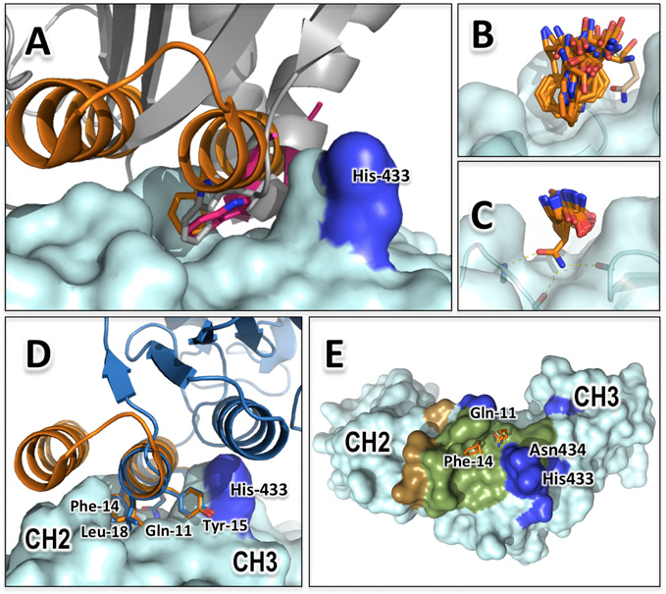
Designing and engineering environmental sensitivity
Computational design of a pH-sensitive IgG binding protein
Computational design of a pH-sensitive IgG binding protein.
Strauch EM, Fleishman SJ, Baker D.
Proc Natl Acad Sci U S A. 2014 Jan 14;111(2):675-80. doi: 10.1073/pnas.1313605111. Epub 2013 Dec 31.

Slide 44
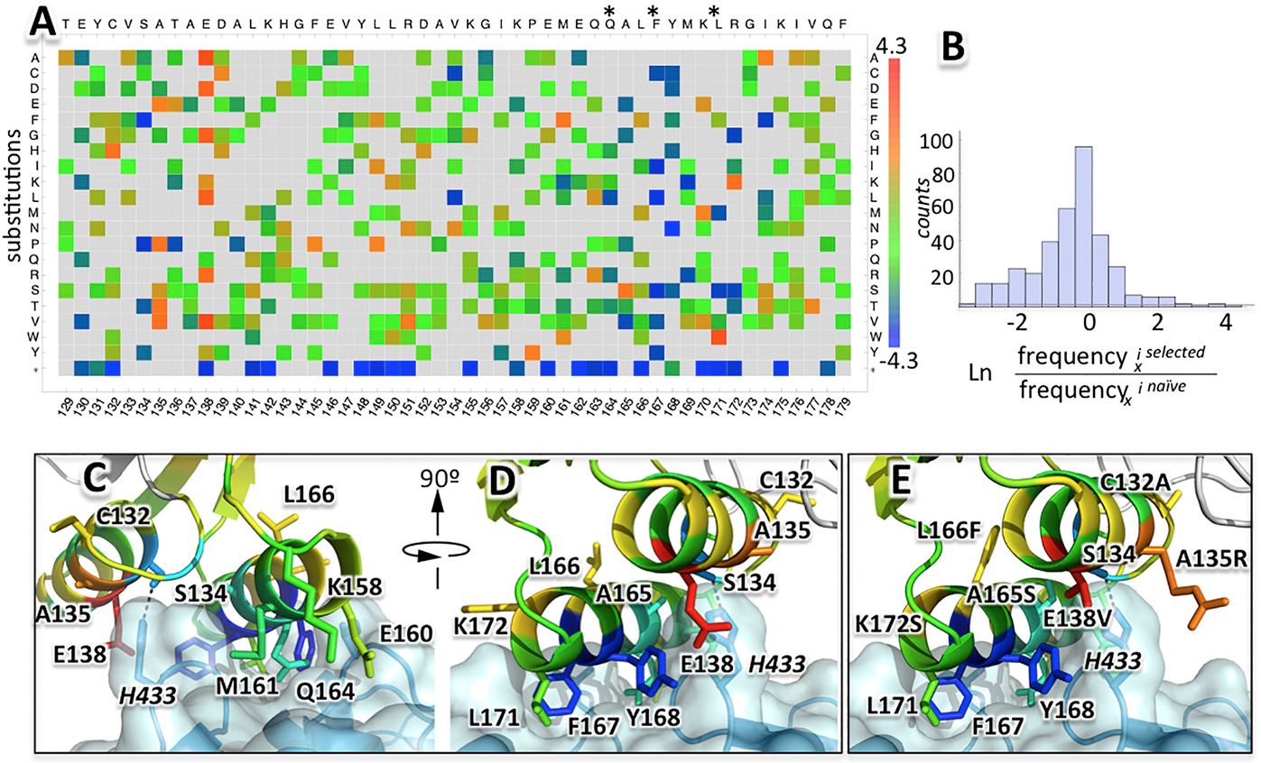
Designing and engineering environmental sensitivity
Computational design of a pH-sensitive IgG binding protein
Mutagenesis
FACS
NGS
Computational design of a pH-sensitive IgG binding protein.
Strauch EM, Fleishman SJ, Baker D.
Proc Natl Acad Sci U S A. 2014 Jan 14;111(2):675-80. doi: 10.1073/pnas.1313605111. Epub 2013 Dec 31.

Slide 45
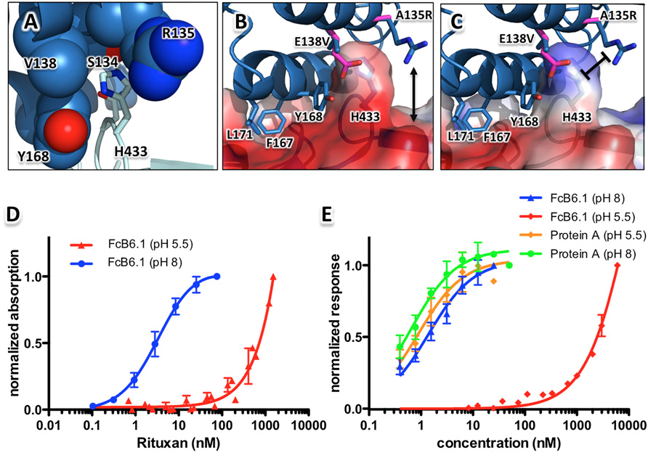
Designing and engineering environmental sensitivity
Computational design of a pH-sensitive IgG binding protein
1. pH sensitive (pH8.2 vs pH5.5, 500 fold)
2. Thermal stability (80C)
3. Chemical stability (3M Urea, 1.5M Guanidine)
4. Binding specificity (hIgG2, hIgG4, hIgG1, mIgG1, mIgG2a)
Computational design of a pH-sensitive IgG binding protein.
Strauch EM, Fleishman SJ, Baker D.
Proc Natl Acad Sci U S A. 2014 Jan 14;111(2):675-80. doi: 10.1073/pnas.1313605111. Epub 2013 Dec 31.

Slide 46
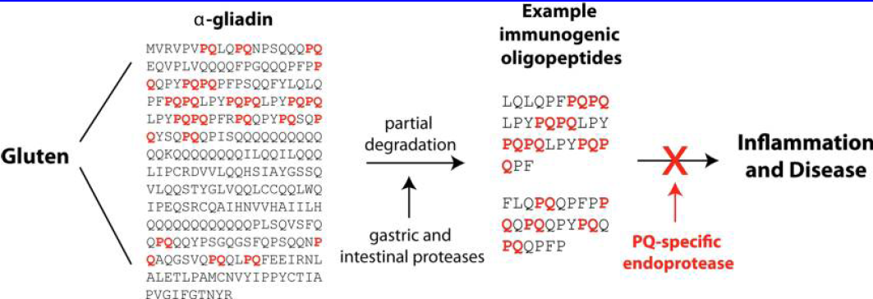
Designing and engineering enzyme activity-1
Computational Design of an α‑Gliadin Peptidase
Ideal oral enzyme therapeutic:
Optimal activity at low pH (2~4)
Resistance to common digestive proteases
Facile recombinant production in soluble form
Specificity for the common PQ motif
Computational design of an α-gliadin peptidase. Baker D, Pultz IS, Siegel JB.
J Am Chem Soc. 2012 Dec 19;134(50):20513-20. doi: 10.1021/ja3094795.

Slide 47
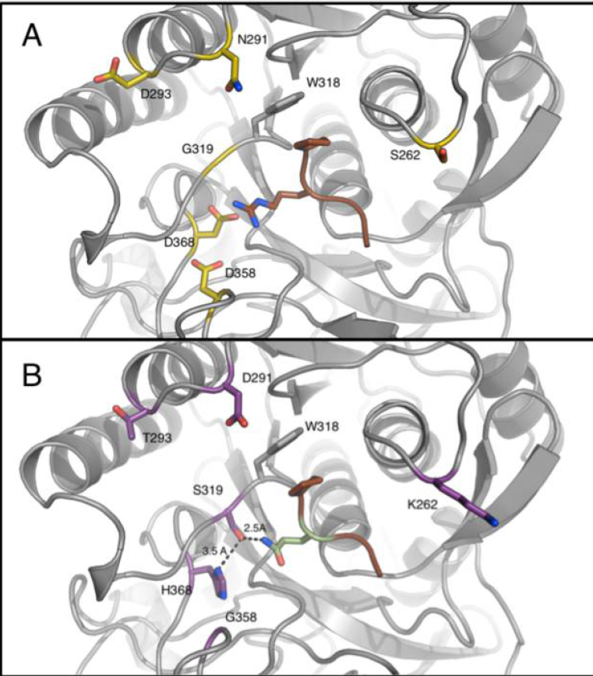
Designing and engineering enzyme activity-1
Computational Design of an α‑Gliadin Peptidase
KumaWT
Optimal activity at low pH (2~4)
Resistance to common digestive proteases
Facile recombinant production in soluble form
Specificity for the common PR/K motif
Computation design
Energy calculation and comparison
116-foldactivity increase
>800 fold switch in substrate specificity
Computational design of an α-gliadin peptidase. Baker D, Pultz IS, Siegel JB.
J Am Chem Soc. 2012 Dec 19;134(50):20513-20. doi: 10.1021/ja3094795.

Slide 48
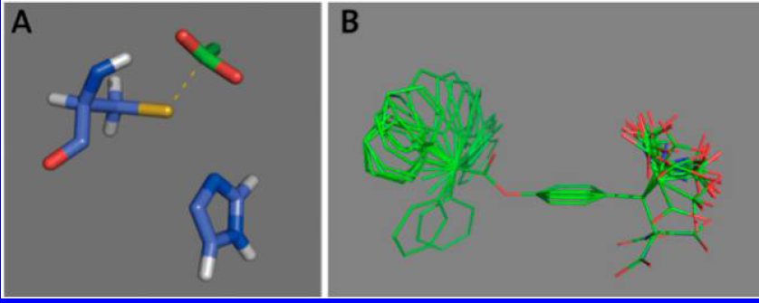
Designing and engineering enzyme activity-2
Catalytic Dyads and Oxyanion Holes for Ester Hydrolysis
Cys-His dyad
Substrate
Computational design of catalytic dyads and oxyanion holes for ester hydrolysis. Baker D.
J Am Chem Soc. 2012 Oct 3;134(39):16197-206. doi: 10.1021/ja3037367.

Slide 49

Designing and engineering enzyme activity-2
Catalytic Dyads and Oxyanion Holes for Ester Hydrolysis
4 active design
Computational design of catalytic dyads and oxyanion holes for ester hydrolysis. Baker D.
J Am Chem Soc. 2012 Oct 3;134(39):16197-206. doi: 10.1021/ja3037367.

Slide 50
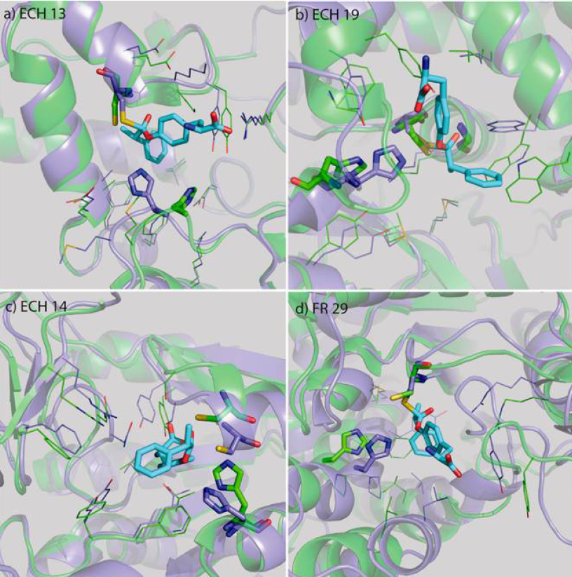
Designing and engineering enzyme activity-2
Catalytic Dyads and Oxyanion Holes for Ester Hydrolysis
His conformation changed
Backbone shift
His in loop region
Dyad not formed
Residue mutation
Dyad not formed
Backbone shift
Computational design of catalytic dyads and oxyanion holes for ester hydrolysis. Baker D.
J Am Chem Soc. 2012 Oct 3;134(39):16197-206. doi: 10.1021/ja3037367.

Slide 51
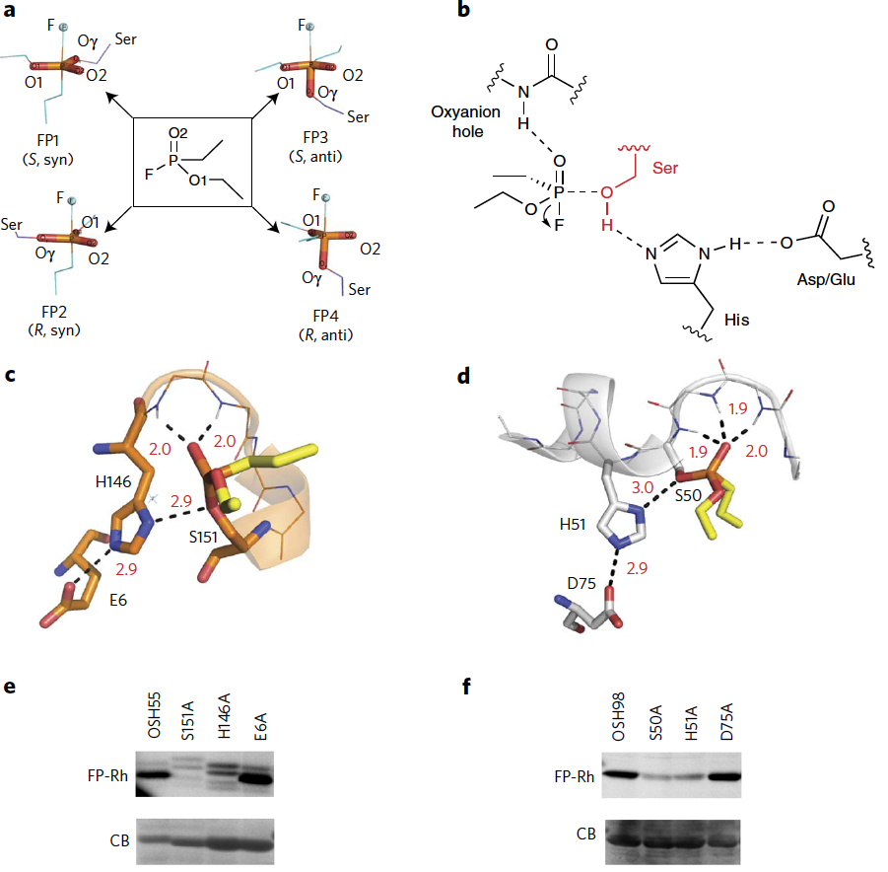
Designing and engineering enzyme activity-3
Design of activated serine–containing catalytic triads with atomic-level accuracy
Design strategy and result
Design of activated serine-containing catalytic triads with atomic-level accuracy.
Baker D. Nat Chem Biol. 2014 May;10(5):386-91. doi: 10.1038/nchembio.1498.

Slide 52
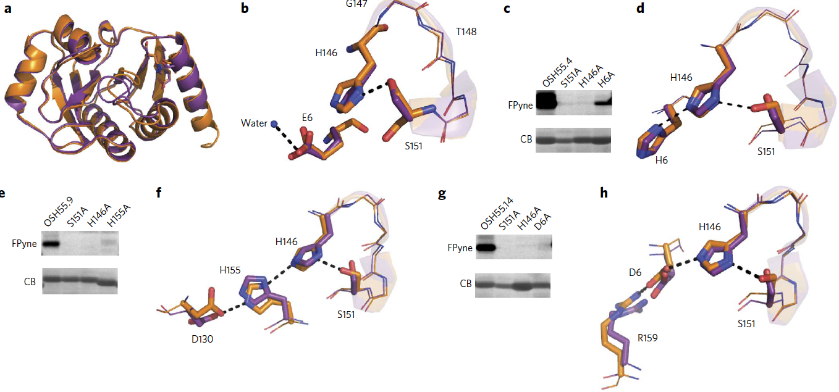
Designing and engineering enzyme activity-3
Design of activated serine–containing catalytic triads with atomic-level accuracy
Computational optimization and validation
Design of activated serine-containing catalytic triads with atomic-level accuracy.
Baker D. Nat Chem Biol. 2014 May;10(5):386-91. doi: 10.1038/nchembio.1498.

Slide 53
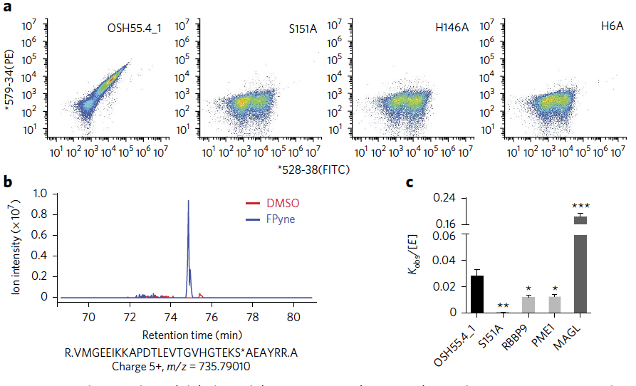
Designing and engineering enzyme activity-3
Design of activated serine–containing catalytic triads with atomic-level accuracy
Evolutional optimization and validation
Design of activated serine-containing catalytic triads with atomic-level accuracy.
Baker D. Nat Chem Biol. 2014 May;10(5):386-91. doi: 10.1038/nchembio.1498.

Slide 54
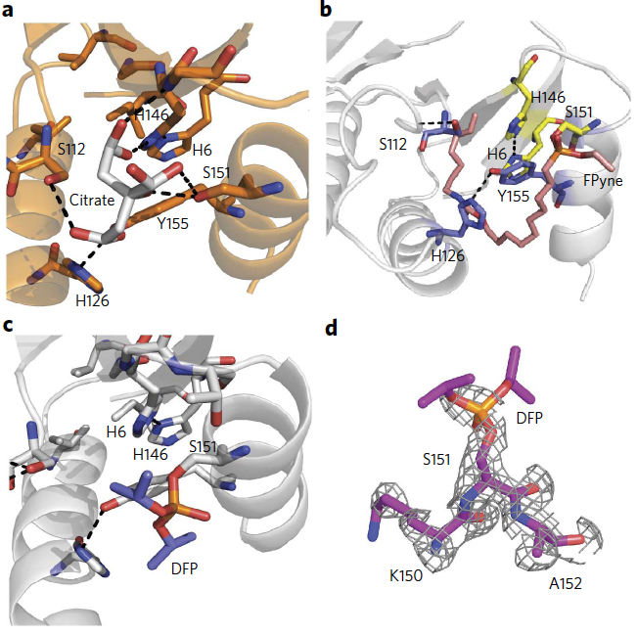
Designing and engineering enzyme activity-3
Design of activated serine–containing catalytic triads with atomic-level accuracy
Apo-Citrate
Probe-bound
DFP-bound
Electron-density
Design of activated serine-containing catalytic triads with atomic-level accuracy.
Baker D. Nat Chem Biol. 2014 May;10(5):386-91. doi: 10.1038/nchembio.1498.

Slide 55
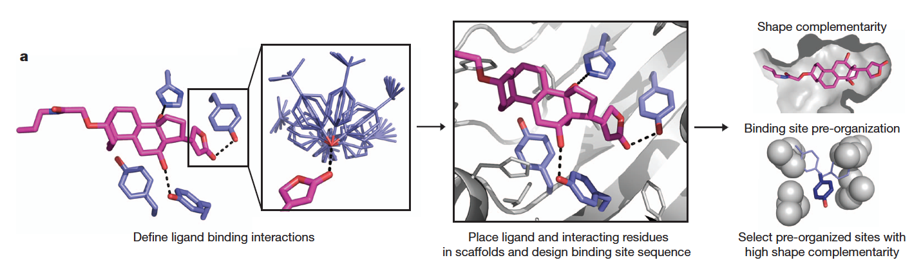
Designing and engineering ligand binding affinity and selectivity
Computational design methodology of DIG-binding protein
Computational design of ligand-binding proteins with high affinity and selectivity.
Tinberg CE, Khare SD, Dou J, Doyle L, Nelson JW, Schena A, Jankowski W, Kalodimos CG, Johnsson K, Stoddard BL, Baker D.
Nature. 2013 Sep 12;501(7466):212-6. doi: 10.1038/nature12443. Epub 2013 Sep 4.

Slide 56
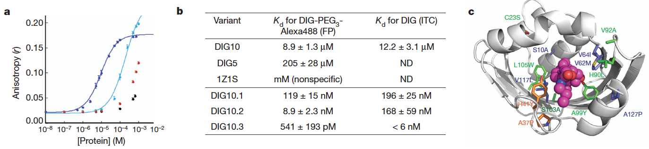
Designing and engineering ligand binding affinity and selectivity
Computational design combined with experimental mutagenesis
DIG5
DIG10
BSA
Scaffold
Dissociation constants of designs
Mutations identified during maturation (Blue for 10.1, orange for 10.2 and green for 10.3)
Equilibrium fluorescence anisotropy
Saturated mutagenesis
Yeast surface display & FACS
Doped oligonucleotide mutagenesis
Computational design of ligand-binding proteins with high affinity and selectivity.
Tinberg CE, Khare SD, Dou J, Doyle L, Nelson JW, Schena A, Jankowski W, Kalodimos CG, Johnsson K, Stoddard BL, Baker D.
Nature. 2013 Sep 12;501(7466):212-6. doi: 10.1038/nature12443. Epub 2013 Sep 4.

Slide 57
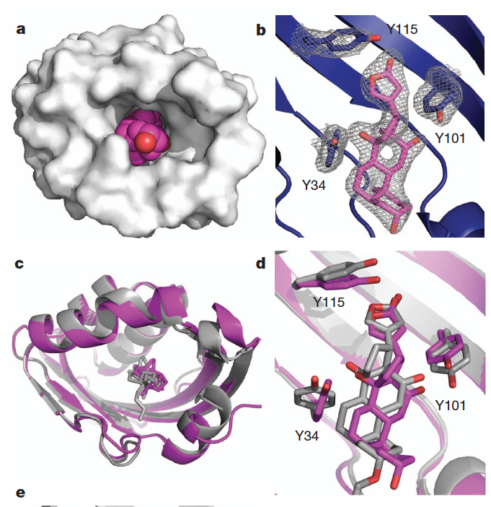
Designing and engineering ligand binding affinity and selectivity
DIG10.2-DIG complex
Structure validation
Comparison with model (grey)
Computational design of ligand-binding proteins with high affinity and selectivity.
Tinberg CE, Khare SD, Dou J, Doyle L, Nelson JW, Schena A, Jankowski W, Kalodimos CG, Johnsson K, Stoddard BL, Baker D.
Nature. 2013 Sep 12;501(7466):212-6. doi: 10.1038/nature12443. Epub 2013 Sep 4.

Slide 58
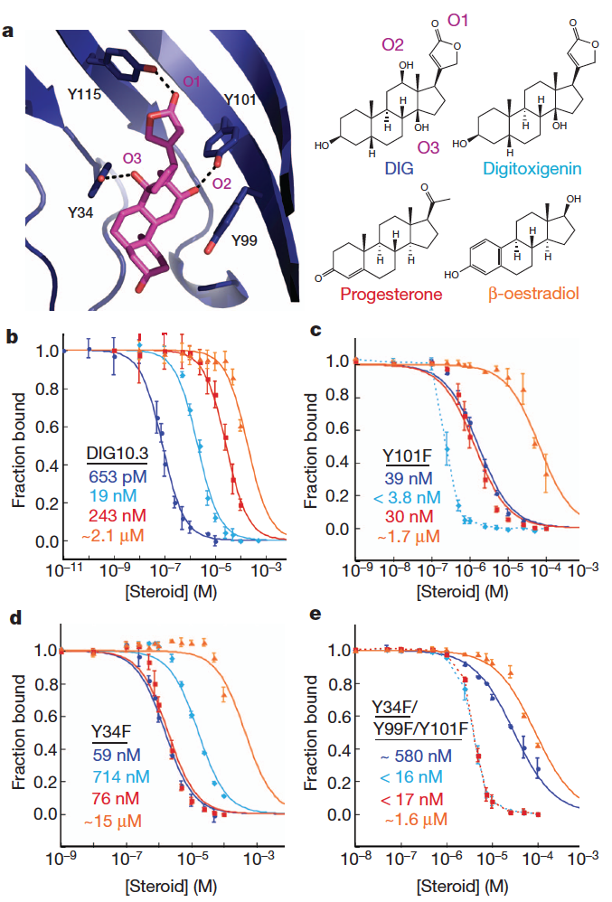
Designing and engineering ligand binding affinity and selectivity
Binding selectivity among different ligands
Computational design of ligand-binding proteins with high affinity and selectivity.
Tinberg CE, Khare SD, Dou J, Doyle L, Nelson JW, Schena A, Jankowski W, Kalodimos CG, Johnsson K, Stoddard BL, Baker D.
Nature. 2013 Sep 12;501(7466):212-6. doi: 10.1038/nature12443. Epub 2013 Sep 4.

Slide 59
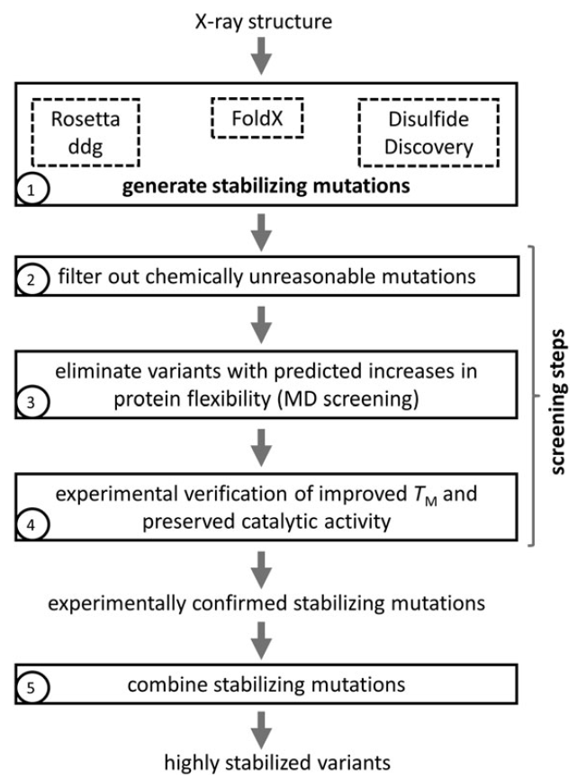
Designing and engineering enzyme stability and selectivity
Computationally designed libraries for rapid enzyme stabilization
Framework for Rapid Enzyme Stabilization by Computational libraries (FRESCO)
Computationally designed libraries for rapid enzyme stabilization. Wijma HJ, Floor RJ, Jekel PA, Baker D, Marrink SJ, Janssen DB.
Protein Eng Des Sel. 2014 Feb;27(2):49-58. doi: 10.1093/protein/gzt061. Epub 2014 Jan 8.

Slide 60
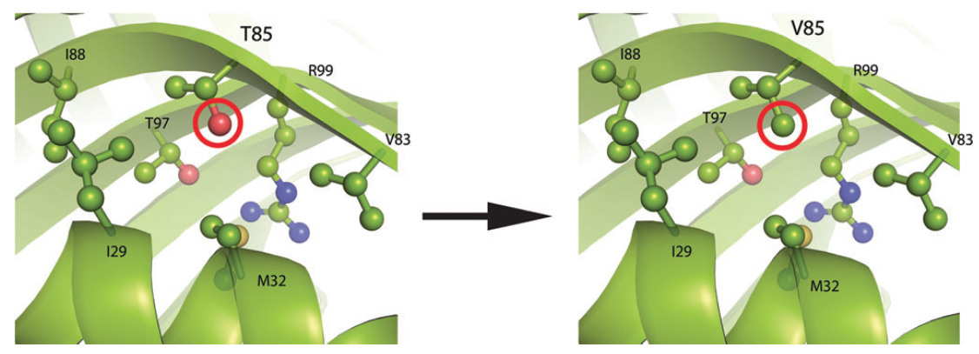
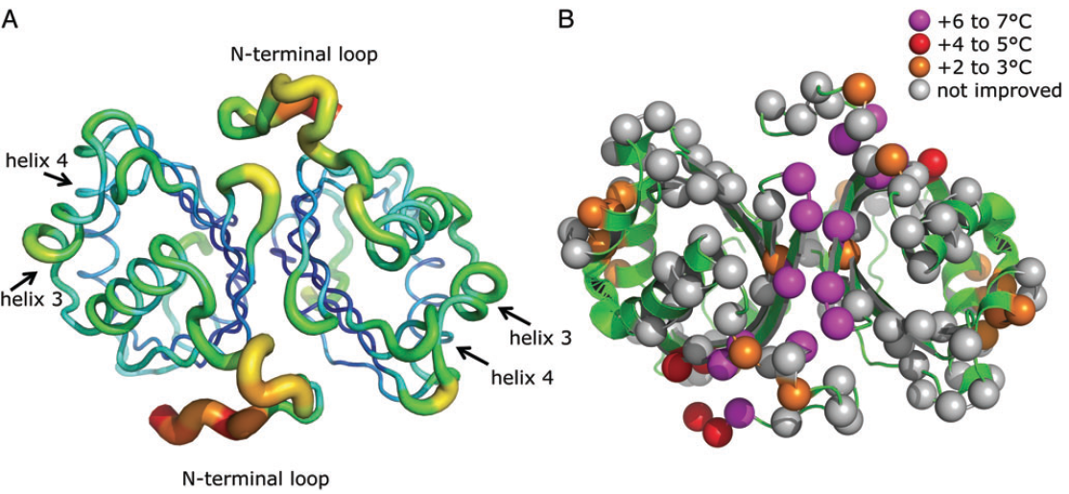
Designing and engineering enzyme stability and selectivity
Examples of the predicted structure for a stabilization mutation
Distribution of the stabilizing mutations over the protein
B-factors of the Ca trace
Mutations

Slide 61
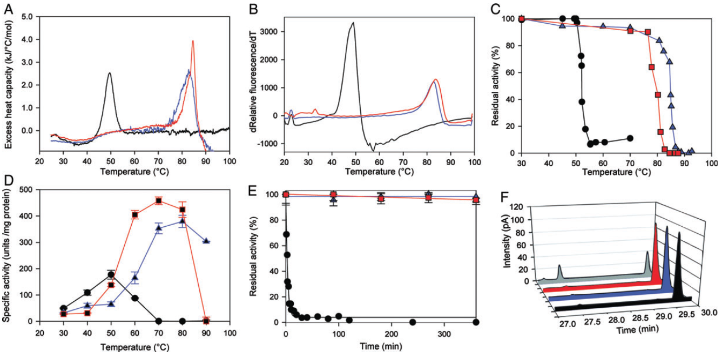
Designing and engineering enzyme stability and selectivity
Overview of the improved stability of the LEH mutants F1 and F2
DSC
thermofluor
Remaining activity after pre-incubation at different Temp
Optimal Temp
Inactivation at 55C
Retained regio-selectivity

Slide 62
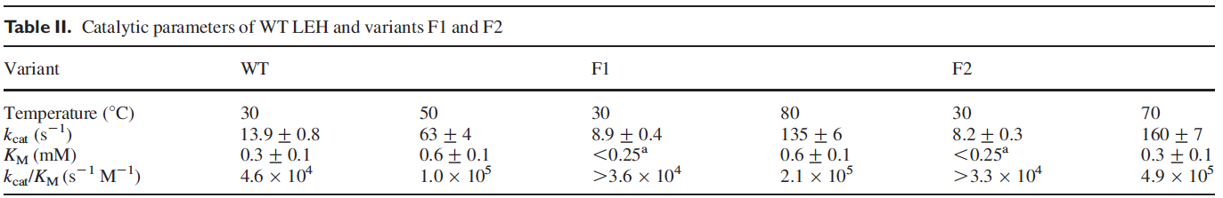
Designing and engineering enzyme stability and selectivity
Tm increase from 50C to 85C
Activity increase
Half-life >250 fold longer
Computationally designed libraries for rapid enzyme stabilization. Wijma HJ, Floor RJ, Jekel PA, Baker D, Marrink SJ, Janssen DB.
Protein Eng Des Sel. 2014 Feb;27(2):49-58. doi: 10.1093/protein/gzt061. Epub 2014 Jan 8.

